Slide 1
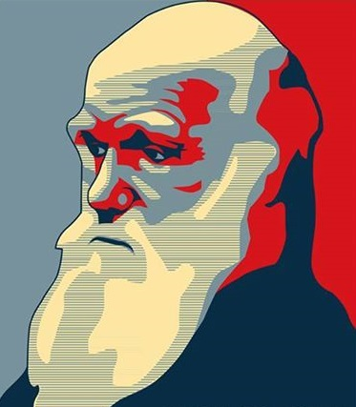


AND
LIFE FORMS
GEOLOGICAL TIME SCALE
Compiled by Ms.Sruthy Sajeev from various sources for M.Sc Seminar presentation

Slide 2
What does the time scale represent?
The geological time scale is the total life span of earth.
divides up the history of the earth based on life-forms that have existed during specific times since the creation of the planet.
Most of these life-forms are found as fossils, which are the remains or traces of an organism that has been preserved in sediment or rock.
Notes:
Evolutionary

Slide 3
The Evolutionary Time Scale is divided as follows:
Eons: Longest division; based on the abundance of certain fossils.
Eras: Next to the longest subdivision; marked by major changes in the fossil record.
Periods: Based on types of life existing at the time.
Epochs: Shortest subdivision; marked by differences in life forms and can vary from continent to continent.

Slide 4
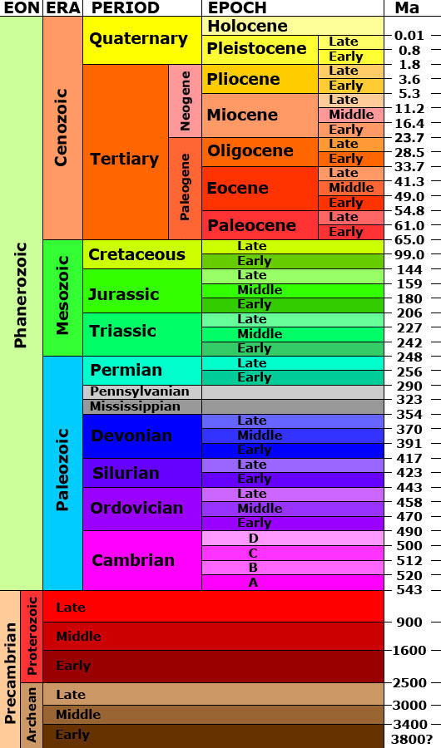

Slide 5
EONS

Slide 6
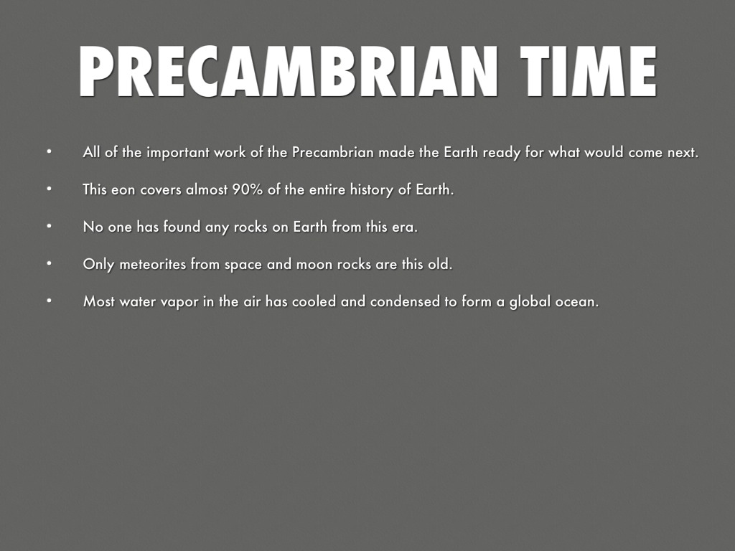
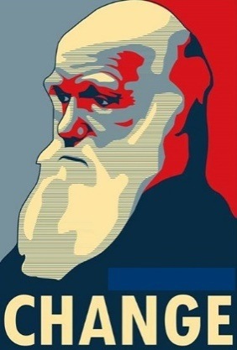
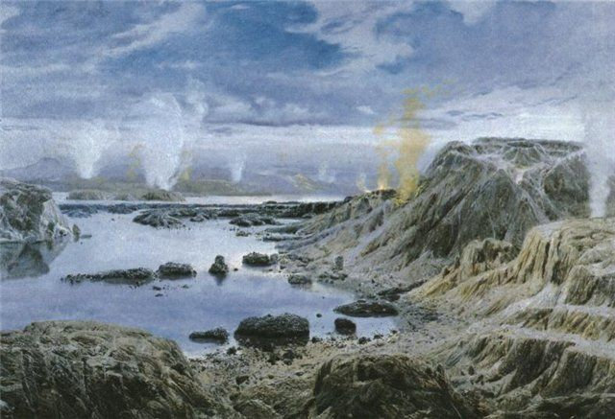
Archean
Proterozoic

Slide 7
Phanerozoic Eon
541 million years to the present.
Its name derives from the Ancient Greek words meaning ”visible life”

Slide 8
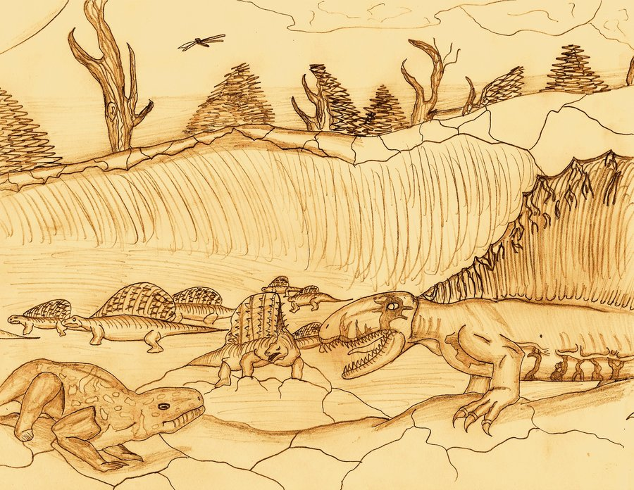
Paleozoic Era

Slide 9
Paleozoic Era
It is the earliest of three geologic eras of the Phanerozoic Eon, spanning from 541 to 252.17 million years ago. It is the longest of the Phanerozoic eras.
Life began in the ocean but eventually transitioned onto land by the late Paleozoic.
The Paleozoic Era ended with the largest mass extinction in Earth's history, the Permian–Triassic extinction event.

Slide 10
Periods of the Paleozoic Era
    Permian Period
    Carboniferous Period
    Devonian Period
    Silurian Period
    Ordovician Period
    Cambrian Period

Slide 11
Cambrian Period
The Cambrian spans from 541 million years to 485 million years ago and is the first period of the Paleozoic.
Creatures like algae evolved, but most of the water was populated by armored arthropods, like trilobites.
Almost all marine phyla evolved in this period.
During this time, the super-continent Rodinia begins to break up, most of which becomes the super-continent Gondwana.

Slide 12
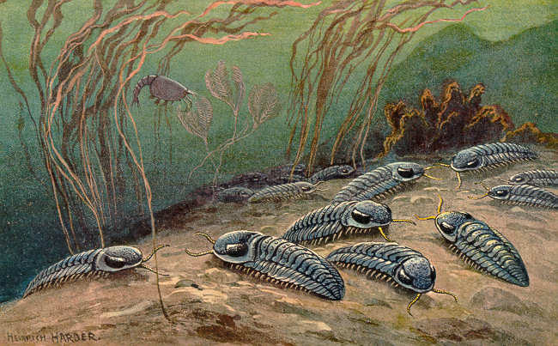
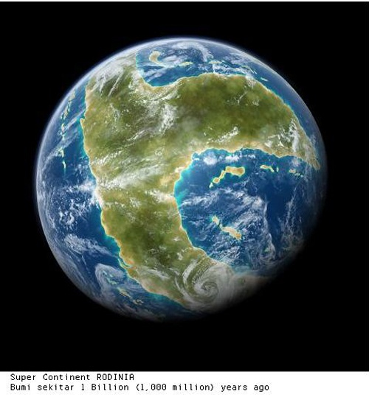
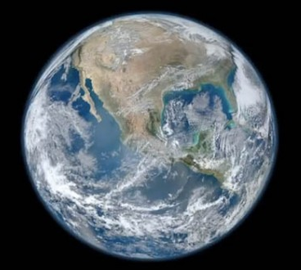
Trilobites
Rodinia
Gondwana

Slide 13
Cambrian Explosion
The Cambrian explosion or Cambrian radiation, was the relatively short evolutionary event, beginning around 542 million years ago.
In the Cambrian Period, during which most major animal phyla appeared, as indicated by the fossil record.
Lasting for about the next 20–25 million years, it resulted in the divergence of most modern metazoan phyla.
Additionally, the event was accompanied by major diversification of other organisms.

Slide 14
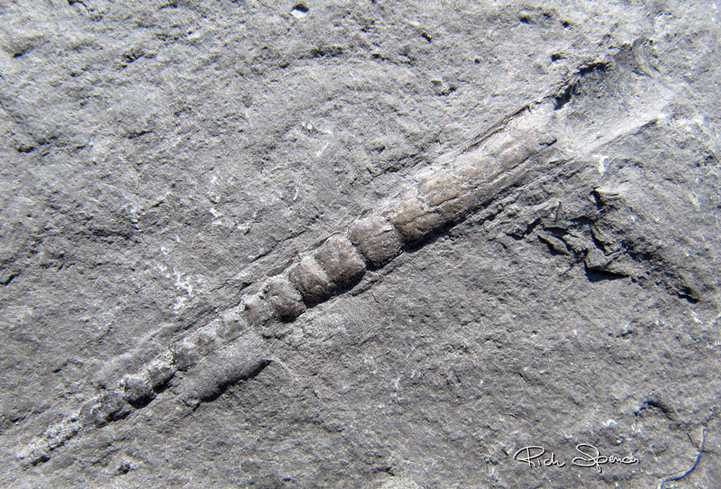
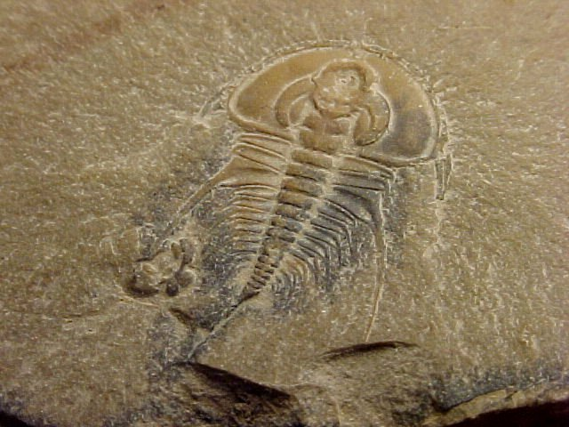
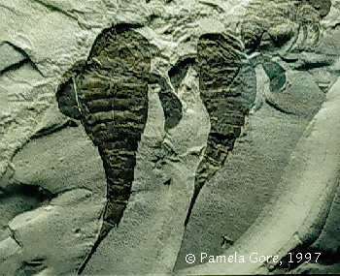
Ordovician Period
The Ordovician spans from 485 million years to 443 million years ago.
The Ordovician is a time in Earth's history in which many species still prevalent today evolved, such as primitive fish, cephalopods, and coral. The most common forms of life, however, were snails, trilobites and shellfish.
More importantly, the first arthropods went ashore to colonize the empty continent of Gondwana.

Slide 15
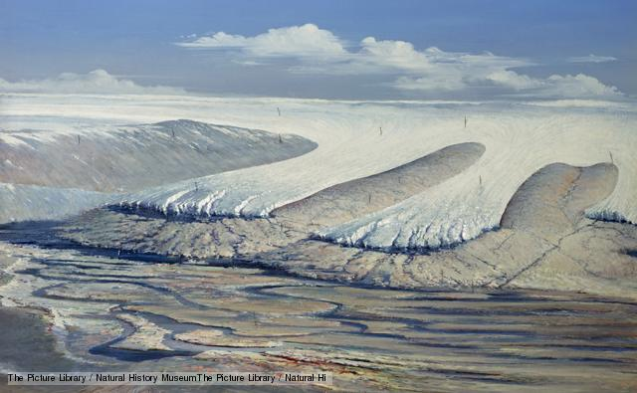
Ordovician-Silurian Mass Extinction
443 million years ago
An ice age has been blamed for the extinction - a huge ice sheet in the southern hemisphere caused climate change and a fall in sea level, and changed the chemistry of the oceans.
During the Ordovician, most life was in the sea, so it was sea creatures such as trilobites, brachiopods and graptolites that were drastically reduced in number.
In all, some 85% of sea life was wiped out. in which 60% of marine invertebrates and 25% of families went extinct. Created the snowball earth.

Slide 16
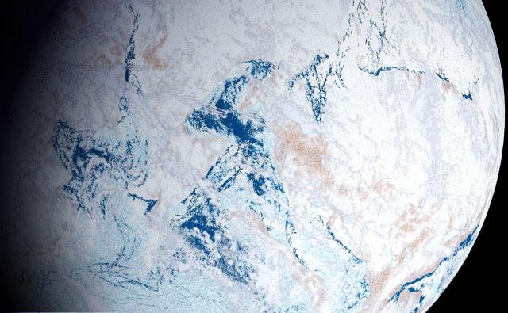
Snowball Earth

Slide 17
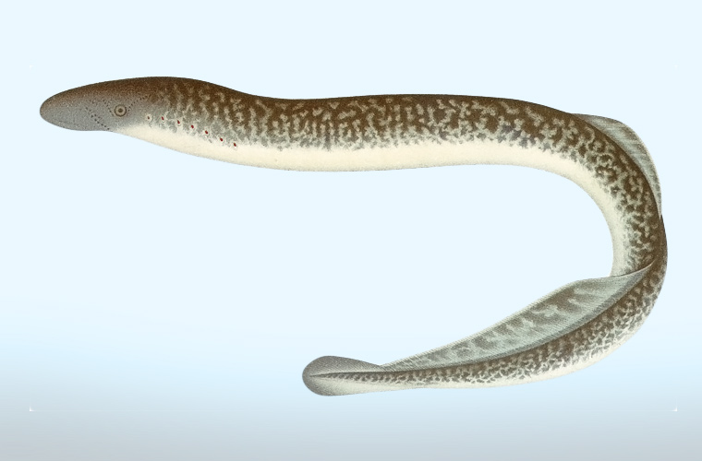
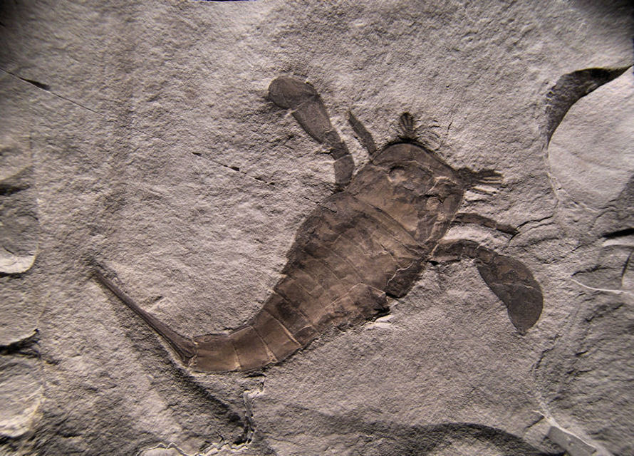
Silurian Period
The Silurian spans from 443 million years to 419 million years ago. The Silurian saw the healing of the earth that recovered from the snowball earth.
This period saw the mass evolution of fish, as jaw-less fish became more numerous, jawed fish evolved, and the first freshwater fish evolved, though arthropods, such as sea scorpions, were still apex predators.

Slide 18
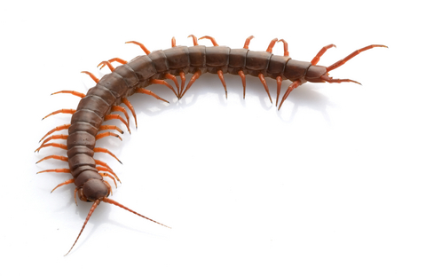
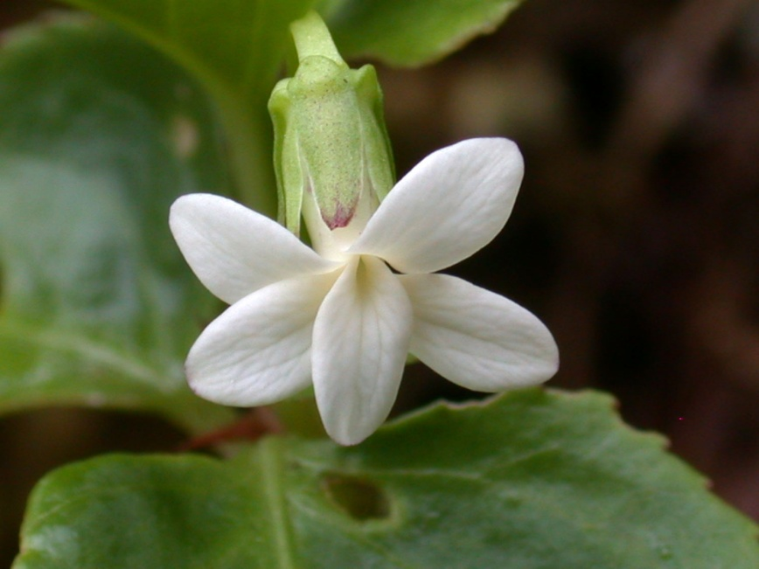
Fully terrestrial life evolved, which included early arachnids, fungi, and centipedes.
Also, the evolution of vascular plant allowed plants to gain a foothold on land.

Slide 19
During this time, there are four continents:
Gondwana ; Africa, South America, Australia, Antarctica, Siberia.
Laurentia ; North America
Baltica ; Northern Europe
Avalonia ; Western Europe
The recent rise in sea levels provided many new species to thrive in water.

Slide 20
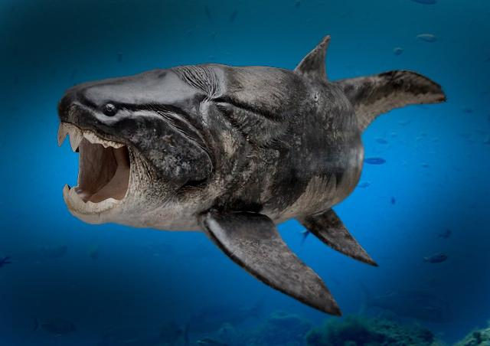
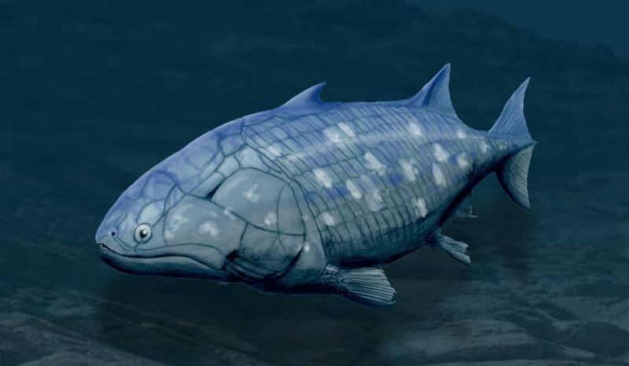
Devonian Period
The Devonian spans from 419 million years to 359 million years ago.
Also known as "The Age of the Fish", the Devonian features a huge diversification of fish, including armored fish like Dunkleosteus and lobe-finned fish which eventually evolved into the first tetrapods.

Slide 21
On land, plant groups diversified incredibly in an event known as the Devonian Explosion where the first trees evolved, as well as seeds.
This event also diversified arthropod life.
The first amphibians also evolved, and the fish were now at the top of the food chain.
Near the end of the Devonian, 70% of all species went extinct in an event known as the Late Devonian extinction. and is the second mass extinction event the world has seen.

Slide 22
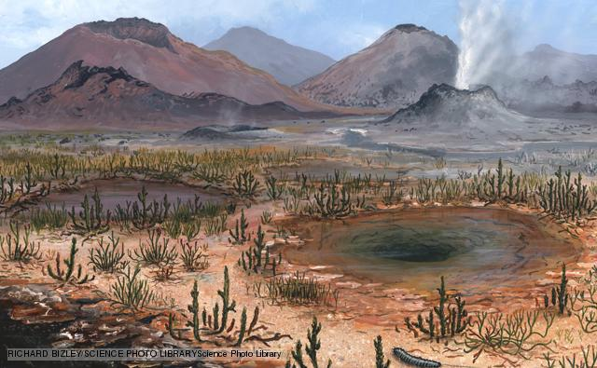
Late Devonian Mass Extinction
359 million years ago

Slide 23
Changes in sea level, asteroid impacts, climate change and new kinds of plants altering the soil have all been blamed for these extinctions.
Three quarters of all species on Earth died out in the Late Devonian mass extinction.
Life in the shallow seas were the worst affected, and reefs took a hammering, not returning to their former glory until new types of coral evolved over 100 million years later.

Slide 24
Carboniferous Period
359 to 299 Mya.
During this time, average global temperatures were exceedingly high.
Tropical swamps dominated the earth, and the large amounts of trees created much of the carbon for the coal that is used today (hence the name "Carbon-iferous").
Perhaps the most important evolutionary development of the time was the evolution of amniotic eggs, which allowed amphibians to head farther inland and remained the dominant vertebrae throughout the duration of this period.

Slide 25
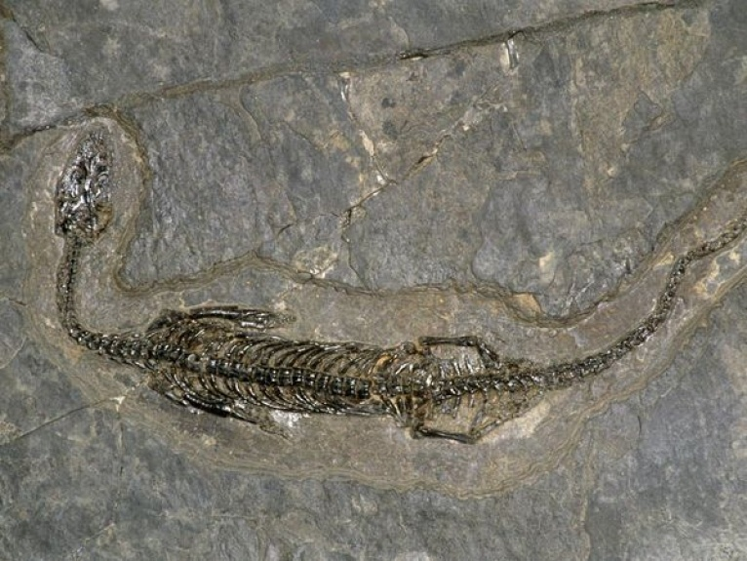
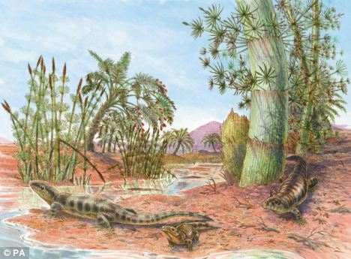
Also, the first reptiles evolved in the swamps.
Throughout the Carboniferous, there was a cooling pattern, which eventually led to the glaciation : an event known as the Carboniferous Rainforest Collapse.

Slide 26
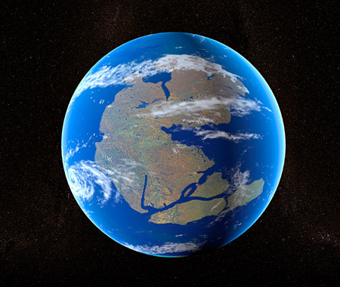
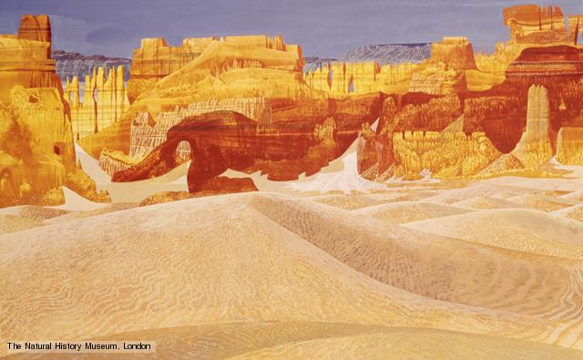
Permian Period
The Permian spans from 299 million to 252 million years ago and was the last period of the Paleozoic.
At the beginning, all continents joined together to form the super-continent Pangaea which was encircled by one ocean called Panthalassa.

Slide 27
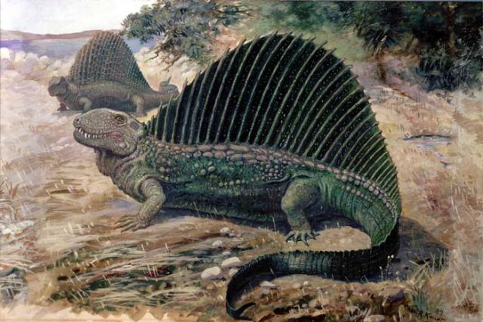
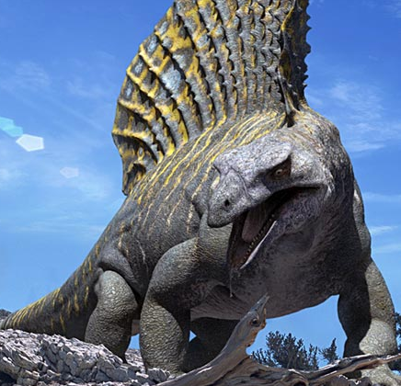
The earth was very dry during this time, with harsh seasons as the climate of the interior of Pangaea wasn't regulated by large bodies of water.
Reptiles and synapsids flourished in the new dry climate. Creatures such as Dimetrodon and Edaphosaurus ruled the new continent.

Slide 28
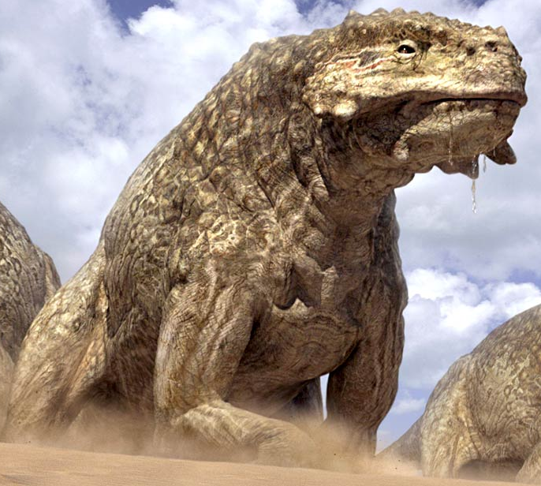
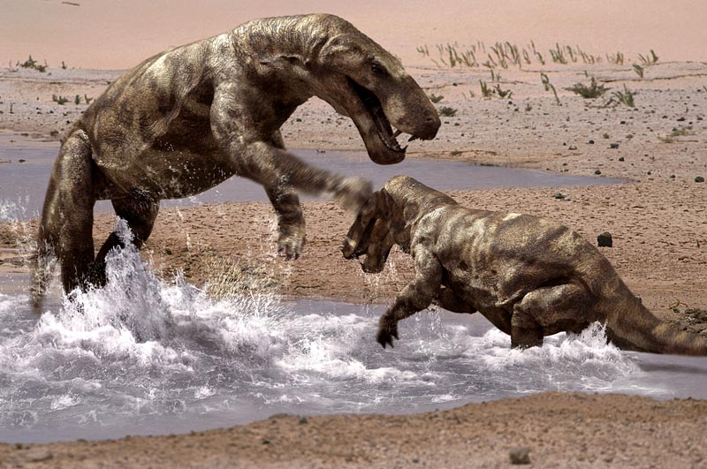
The end of the Permian, however, Pangaea got drier and drier. The interior was nothing but dry deserts. Scutosaurus and Gorgonopsids filled the empty desert.

Slide 29
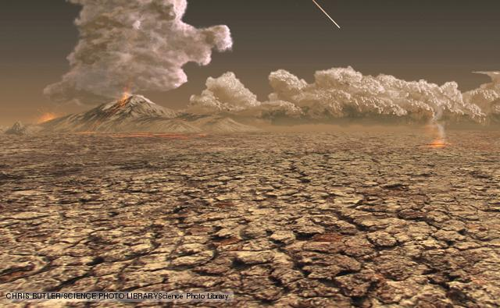
Permian Mass Extinction
248 million years ago

Slide 30
Many causes have been proposed for the event: asteroid impact, catastrophic methane release, a drop in oxygen levels, sea level fluctuations or some combination of these.
The event turns out to have been complex, as there were at least two separate phases of extinction spread over millions of years.
Marine creatures were particularly badly affected and insects suffered the only mass extinction of their history.
96% of all life are gone and it is nicknamed as "The Great Dying", the third and most severe mass extinction in world history.

Slide 31
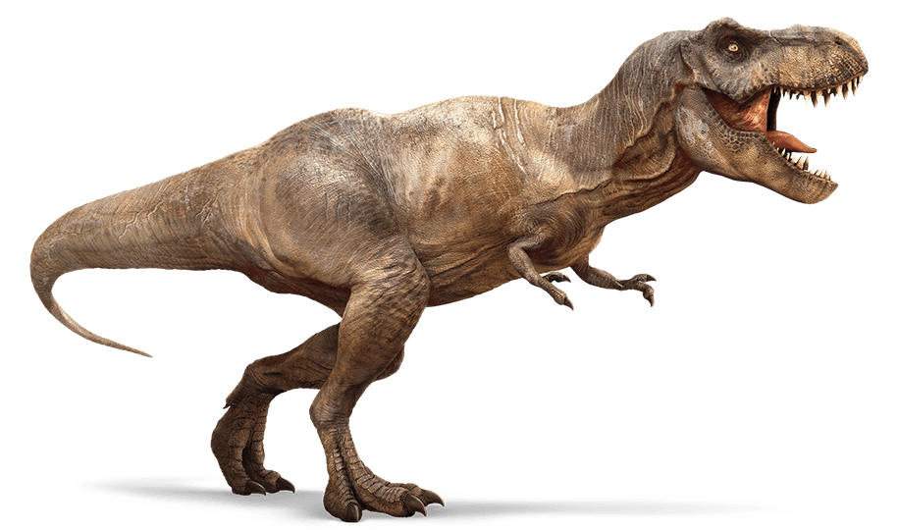
Mesozoic Era

Slide 32
Mesozoic Era
The Mesozoic Era is an interval of geological time from about 252 to 66 million years ago. It is also called the ”Age of Reptiles”. (Gideon Mantell).
Mesozoic means "middle life", deriving from the Greek.
Periods of Mesozoic Era
Triassic
Jurassic
Cretaceous

Slide 33
Triassic Period
The Triassic ranges from 250 million to 200 million years ago.
The Triassic is a desolate transitional state in Earth's history between the Permian Extinction and the lush Jurassic Period.
It has three major epochs:
Early Triassic
Middle Triassic
Late Triassic.

Slide 34
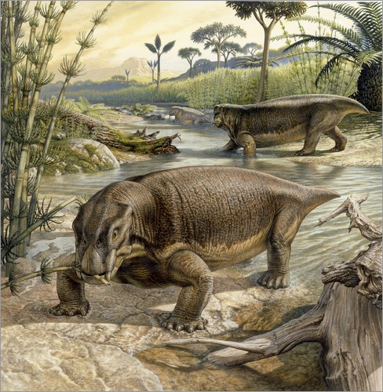
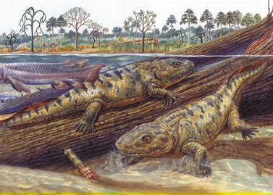
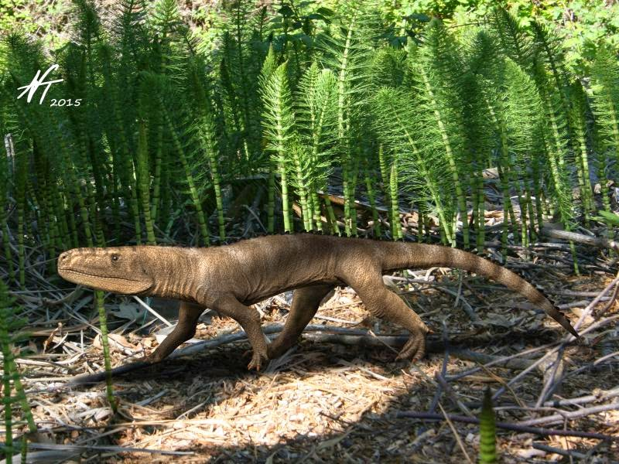
The Early Triassic Epoch
between 250 million to 247 million years ago and was dominated by deserts.
The most common life on earth were Lystrosaurus, Labyrinthodont, and Euparkeria along many other creatures that managed to survive the Great Dying.
Temnospondyli evolved during this and with time would be the dominant predator for much of the Triassic.

Slide 35
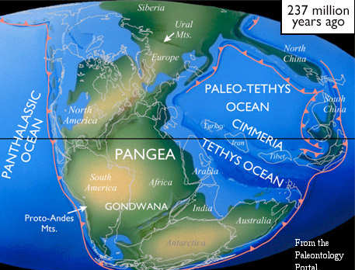
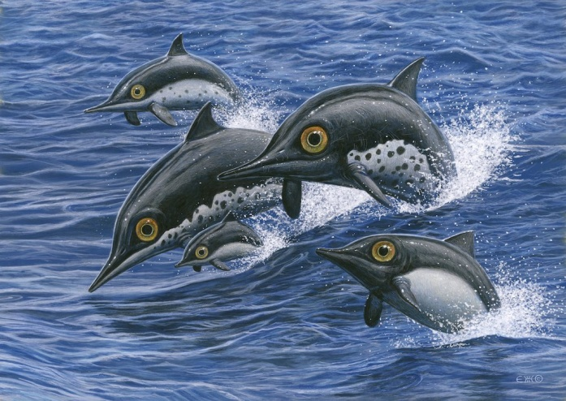
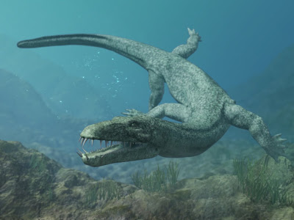
The Middle Triassic spans from 247 million to 237 million years ago.
The Middle Triassic featured the beginnings of the breakup of Pangaea, and the beginning of the Tethys Sea.
The ecosystem had recovered from the devastation that was the Great Dying. Phytoplankton, coral, and crustaceans emerged.
New aquatic reptiles evolved such as Ichthyosaurs and Nothosaurs.
The Middle Triassic Epoch

Slide 36
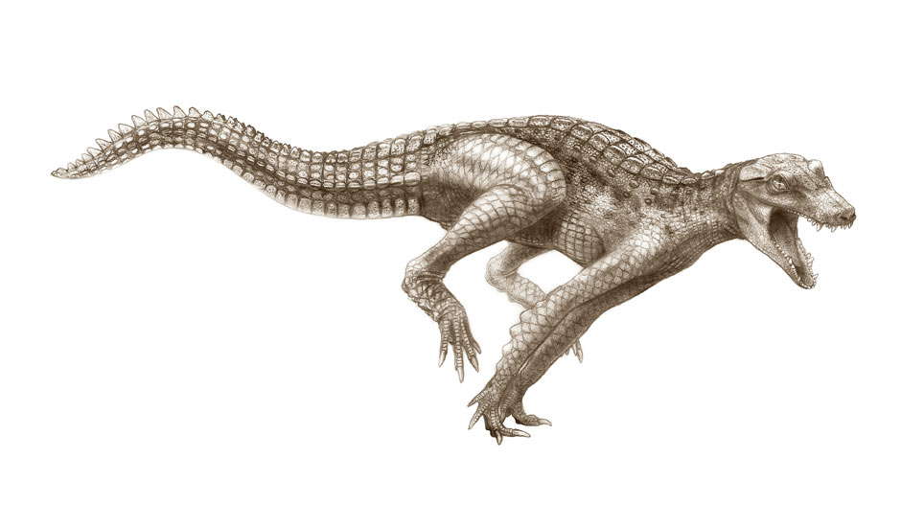
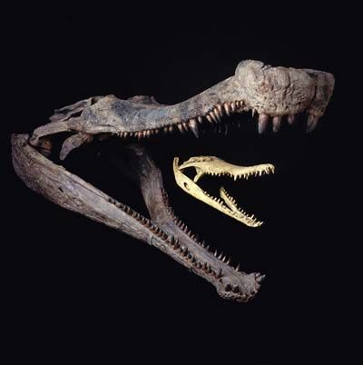
Meanwhile, on land, Pine forests flourished, bringing along mosquitoes and fruit flies.
The first ancient crocodilians evolved, which sparked competition with the large amphibians that had since ruled the freshwater world.

Slide 37
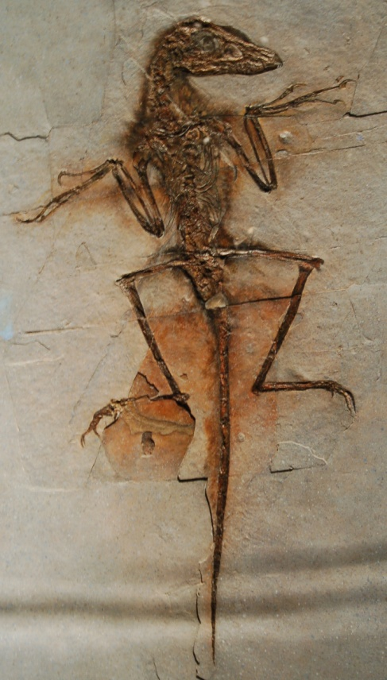
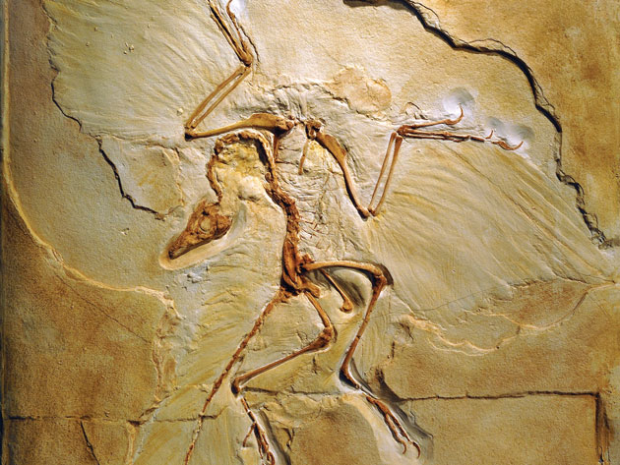
Late Triassic Epoch
The Late Triassic spans from 237 million to 200 million years ago.
The recent warming led to a boom of reptilian evolution on land as the first true dinosaurs evolve, as well as pterosaurs.

Slide 38
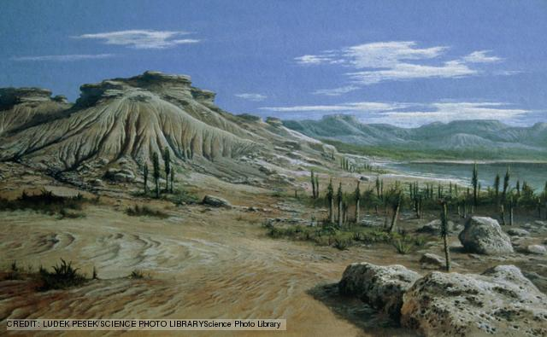
Triassic-Jurassic mass extinction
200 million years ago

Slide 39
Climate change, flood, basalt eruptions and an asteroid impact have all been blamed for this loss of life.
Many types of animal died out, including lots of marine reptiles, some large amphibians.
Roughly half of all the species alive at the time became extinct. Strangely, plants were not so badly affected.
34% of marine life were wiped out in the fourth mass extinction event of the world. The cause is debatable.

Slide 40
Jurassic Period
The Jurassic ranges from 200 million years to 145 million years ago.
It features 3 major epochs:
The Early Jurassic
Middle Jurassic
Late Jurassic.

Slide 41
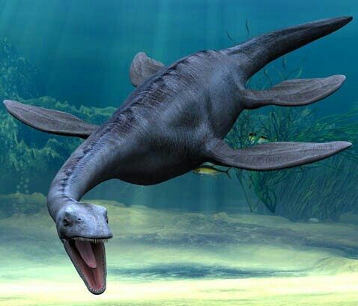
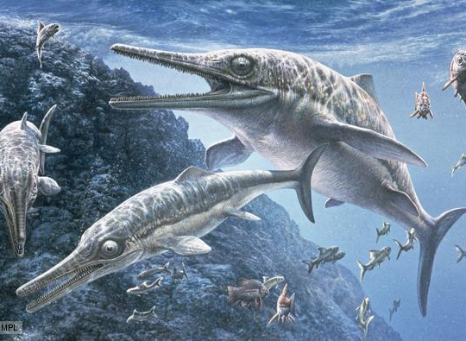
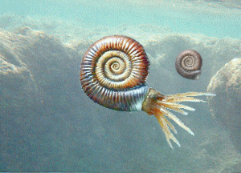
The Early Jurassic
It spans from 200 million years to 175 million years ago.
The climate was much more humid than the Triassic, and as a result, the world was very tropical.
In the oceans, Plesiosaurs, Ichthyosaurs and Ammonites fill waters as the dominant species of the seas

Slide 42
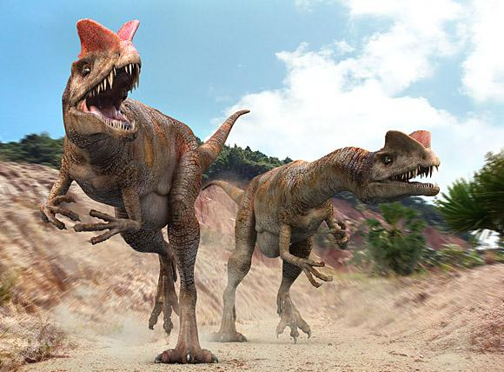
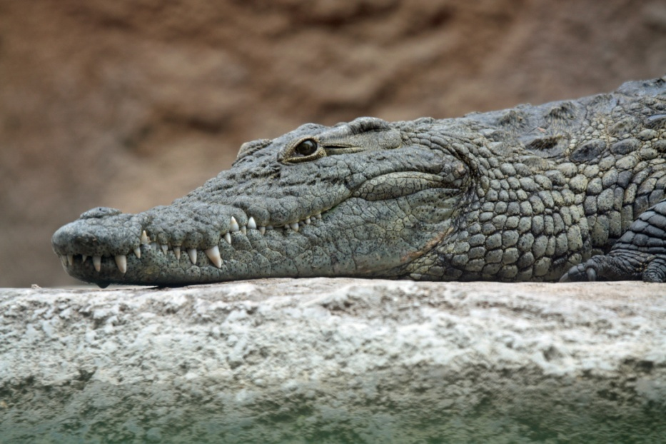
On land, dinosaurs and other reptiles stake their claim as the dominant race of the land, with species such as Dilophosaurus at the top.
The first true crocodiles evolved, pushing out the large amphibians to near extinction. All-in-all, reptiles rise to rule the world. Meanwhile, the first true mammals evolve, but remained relatively small sized.

Slide 43
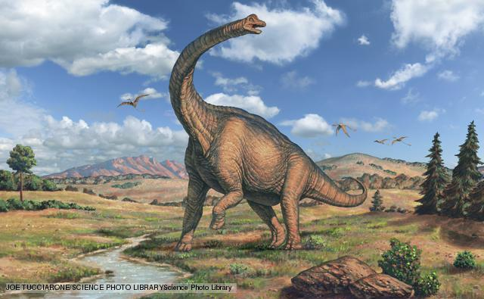
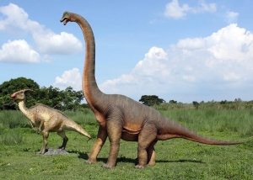
Middle Jurassic Epoch
The Middle Jurassic spans from 175 million to 163 million years ago.
During this epoch, reptiles flourished as huge herds of sauropods, such as Brachiosaurus and Diplodocus, filled the fern prairies of the Middle Jurassic.
This epoch was the peak of the reptiles.

Slide 44
Late Jurassic Epoch
The Late Jurassic spans from 163 million to 145 million years ago.
The Late Jurassic featured a massive extinction of sauropods and Ichthyosaurs due to the separation of Pangaea into Laurasia and Gondwana in an extinction known as the Jurassic-Cretaceous extinction.

Slide 45
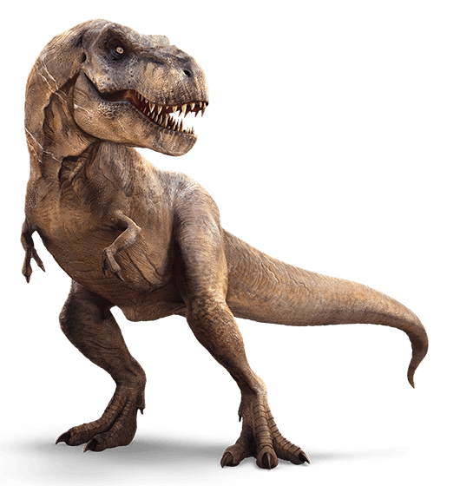

The divided world would give opportunity for the diversification of new dinosaurs. Like the T-Rex.

Slide 46
Cretaceous
The Cretaceous is the longest era in the Mesozoic,
Has two epoch:
Early Cretaceous
Late Cretaceous.
The Early Cretaceous spans from 145 million to 100 million years ago.
The Early Cretaceous saw the expansion of seaways, and as a result, the decline and extinction of sauropods (except in South America).
Many coastal shallows were created, and that caused Ichthyosaurs to die out. Mosasaurs evolved to replace them as head of the seas.

Slide 47

Mosasaurs

Slide 48




Eustreptospondylus
Carcharodontosaurus
Spinosaurus
Iguanodon

Slide 49



Late Cretaceous
Late Cretaceous spans from 100 million to 65 million years ago.
The Late Cretaceous featured a cooling trend that would continue on in the Cenozoic period. Eventually, areas beyond the tropic lines featured extreme seasonal changes in weather.
Hadrosaurs
Triceratops
Ankylosa

Slide 50

At the end of the Cretaceous, the Deccan traps and other volcanic eruptions were poisoning the atmosphere.
As this was continuing, it is thought that a large meteor smashed into earth, creating the Chicxulub Crater in an event known as the K-T Extinction.

Slide 51
Cretaceous-Tertiary mass extinction
The fifth and most recent mass extinction event, It's suggested that the decline was due to flood basalt eruptions affecting the world's climate, combined with drastic falls in sea level.
Then a huge asteroid or comet struck the seabed near the Yucatan Peninsula in Mexico.
In which 75% of life on earth went extinct, including all non-avian dinosaurs.
Everything over 10 kilograms went extinct. The age of the dinosaurs was over.

Slide 52

Cenozoic Era

Slide 53
Cenozoic Era
The Cenozoic Era is the current and most recent of the three.
Covering the period from 65 million years ago to present day.
The Cenozoic is also known as the Age of Mammals, because the extinction of many groups allowed mammals to greatly diversify.
From a geological perspective, it did not take long for mammals and birds to greatly diversify in the absence of the large reptiles that had dominated during the Mesozoic.

Slide 54

Some flightless birds grew larger than the average human. These species are sometimes referred to as "terror birds," and were formidable predators.
Mammals came to occupy almost every available niche.
Climate-wise, the Earth had begun a drying and cooling trend,

Slide 55
Subdivisions Cenozoic Era
The Cenozoic is divided into two periods:
Tertiary Period
Quaternary Period
The Tertiary Period is divided into 5 Epochs
Pliocene
Miocene
Oligocene
Eocene
Palaeocene
The Quaternary Period is divided into 2 epochs
Holocene
Pleistocene
The Palaeocene, Eocene and Oligocene Epochs are now together called as Palaeogene Period.
The Miocene and Pliocene Epochs are together called as Neogene Period now

Slide 56
Paleocene
Ranged from 65 million to 55 million years ago.
The Paleocene is a transitional point between the devastation that is the K-T extinction, to the rich jungles environment that is the Early Eocene.
The Early Paleocene saw the recovery of the earth. The continents began to take their modern shape.
This epoch featured a general warming trend, with jungles eventually reaching the poles.
Early primates that evolved during the Mesozoic, and as a result, there was nothing over 10 kilograms. Mammals were still quite small.

Slide 57

Eocene
Ranged from 55 million years to 33 million years ago.
life was small and lived in cramped jungles. There were early primates evolved.
At the top of the food chains were huge birds, such as Gastornis. It is the only time in recorded history that birds ruled the world.

Slide 58


Oligocene
Epoch spans from 33 million to 23 million years ago.
The Oligocene featured the expansion of grass which had led to many new species to evolve, including the first elephants, cats, dogs, marsupials and many other species still prevalent today.
A cooling period was still in effect and seasonal rains were as well.
Mammals still continued to grow larger and larger. Paraceratherium, the largest land mammal to ever live evolved during this period.

Slide 59
Miocene
It spans from 23 to 5 million years ago and is a period in which grass spread further across.
Leading to new species such as sea otters to evolve. During this time, perissodactyls thrived, and evolved into many different varieties.
Overall, arid and mountainous land dominated most of the world, as did grazers.
Many new plants evolved, and 95% of modern seed plants evolved in the mid-Miocene.
Notes:
Nonruminant ungulates: horses; tapirs; rhinoceros; extinct forms

Slide 60
Pliocene
The lasted from 5 to 2 million years ago.
The Mediterranean Sea dried up for several million years.
Along with these major geological events, Australopithecus evolved in Africa, beginning the human branch.
Climatic changes brought savannas that are still continuing to spread across the world, Indian monsoons, deserts in East Asia, and the beginnings of the Sahara desert.
The earth's continents and seas moved into their present shapes. The world map has not changed much since.

Slide 61
Quaternary
The Quaternary spans from 3 million to present day, and features modern animals, and dramatic changes in the climate.
It is divided into two epochs:
Pleistocene
Holocene.

Slide 62
Pleistocene
The Pleistocene lasted from 3 million to 12,000 years ago.
This epoch was marked by ice ages as a result of the cooling trend that started in the Mid-Eocene.
Meanwhile, Africa experienced a trend of desiccation which resulted in the creation of the Sahara and Kalahari deserts.
Many animals evolved including mammoths, giant ground sloths, dire wolves, saber-toothed cats, and most famously Homo sapiens.
100,000 years ago marked the end of one of the worst droughts of Africa, and led to the expansion of primitive man.

Slide 63




Megafauna of the Pleistocene
Mammoths
Cave lions
Woolly rhino
Megaloceros

Slide 64
Holocene
The Holocene began 12,000 years ago and lasts until to present day.
Also known as "the Age of Man", the Holocene is marked by the rise of man on his path to sentience.
All recorded history and "the history of the world" lies within the boundaries of the Holocene epoch.
Human activity is blamed for a mass extinction that began roughly 10,000 years ago, though the species becoming extinct have only been recorded since the Industrial Revolution.
This is sometimes referred to as the "Sixth Extinction". 322 species have become extinct due to human activity since the Industrial Revolution.

Slide 65


Slide 66


Slide 67
REFERENCE
Gradstein. F., Ogg. J., Smith.A.,2004. A Geological Time Scale, Cambridge University Press,UK.,585p
Various sources from Internet.

