Slide 1
POROSITY
AND
PERMEABILITY
DR.RAJESH REGHUNATH

Slide 2
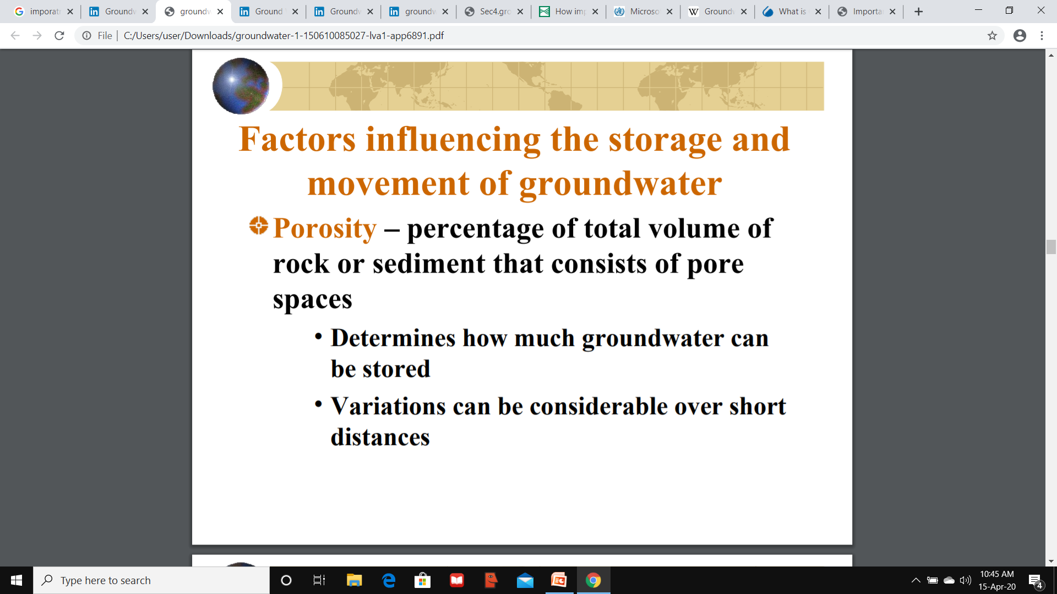
POROSITY
PERMEABILITY

Slide 3
POROSITY
The porosity of a rock is the fraction of the volume of space between the solid particles of the rock to the total rock volume.
The space includes all pores, cracks, vugs, inter- and intra-crystalline spaces.
is expressed either as a fraction varying between 0 and 1, or a percentage varying between 0% and 100%.

Slide 4
POROSITY
The percent of void space in a rock or sediment
It is a measure of the potential volume of water that can be stored in a rock.
Those portions of rock or soil not occupied by solid mineral matter can be occupied by groundwater

Slide 5
Classification of Porosity
Porosity can be classified into (based on origin)
    Original porosity
    Induced porosity
Original porosity (primary) is formed during the deposition of rock materials, e.g. porosity between grains in sandstone, porosity among crystals and oolites in limestone
Induced porosity (secondary) is developed by some geological process after the formation of rock material.
E.g; Fractures, joints, or solution cavity in limestone

Slide 6
Based on size
Capillary porosity : When capillary interstices are sufficiently smaller, then surface tension forces will hold water within them
Super capillary porosity : When the intergranular spaces are larger than capillary ones
Subcapillary porosity : When intergranular spaces are so small that water is held primarily by adhesive forces

Slide 7
Based on nature of pores
Isolated Porosity :Isolated interstices
Communicating Porosity : Communicating interstices

Slide 8
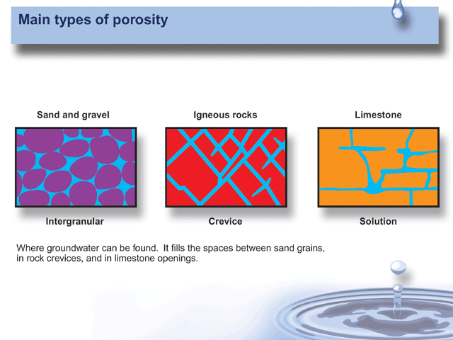

Slide 9
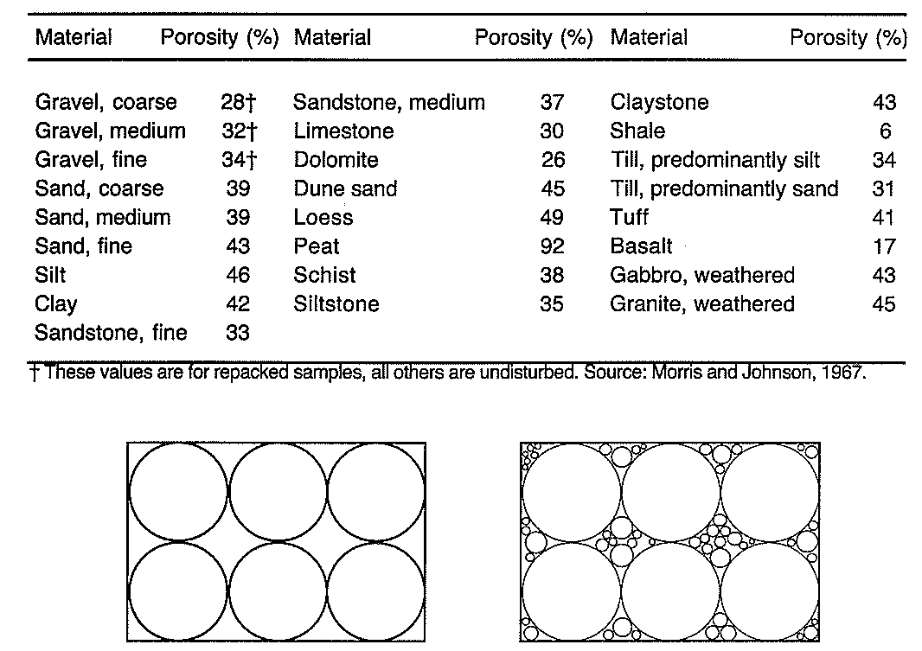
Porosity - not good indicator of flow
Bedient et al., 1999.,

Slide 10
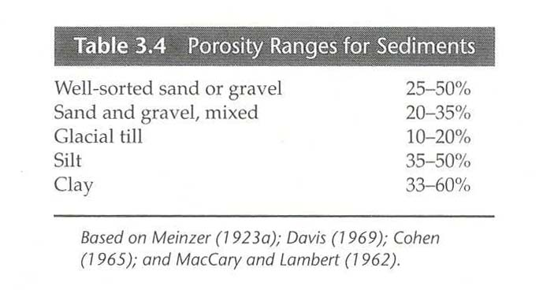

Slide 11
Porosity of sedimentary rocks
Extend of the diagenetic processes determine the extend of porosity
Diagenesis → Compaction, removal or addition of material, transformation of minerals by replacement or phase change.

Slide 12
Porosity of plutonic and metamorphic rocks
Weathering and fracturing – increase overall porosity.
Tectonic stresses - fracturing, faulting, folding.
Fracturing increases porosity by 2% - 5%.
Weathered plutonic rocks can have porosities of 30% - 60%.

Slide 13
Porosity of volcanic rocks
Degassing products → holes in the rock.
Shrinkage cracks → joints
Basalt → 1%-12%.
Pumice : glassy rock formed from lava with high gas -> can be as high as 87%.
Pyroclastic deposits → Tuff : 14% - 40%
Ash – 50%.

Slide 14
Porosity determination
α = 100 V_{i}/V
α = porosity (percentage)
V_{i} = volume of interstices or void space (L³,
cm³, m³)
V = unit (or total) volume of material including voids and solids.

Slide 15
Porosity Determination
α = 100 [1 – (ρ_{b}/ρ_{d})]
α = porosity (percentage).
ρ_{b} = bulk density of aquifer material.
ρ_{d} = particle density of aquifer
material/mineral particles.

Slide 16
Factors affecting Porosity
Shape and arrangements of individual grains (Sorting)
Distribution of pore space by size
Degree of cementation and compaction
Extent of solution activity
Extent of fracturing

Slide 17
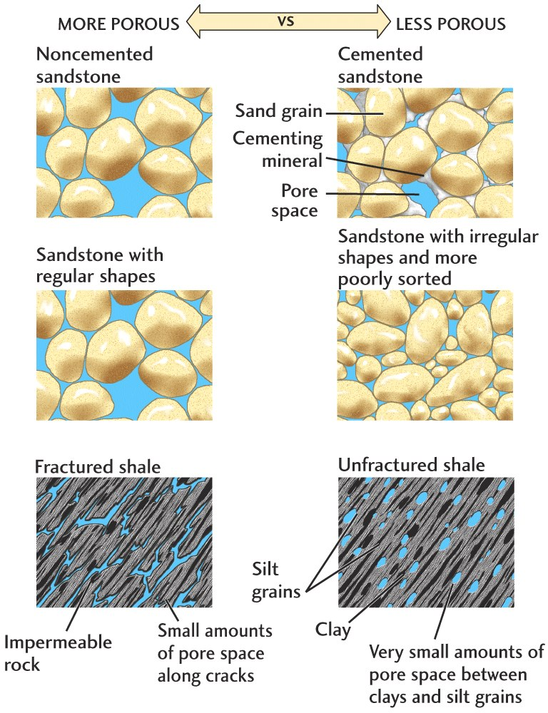
Porosity varies with
% Cement
Sorting
Fracturing
Figure 13.7

Slide 18
Measurement of Porosity
Direct methods
Gravimetric methods
Indirect methods
Neutron Probe method

Slide 19
Direct methods
Removal of water from a sample by:
Evaporation, Leaching or by chemical reaction
and later followed by measurement of the water that is removed

Slide 20
Gravimetric method
By weight difference:
Find out the dry weight of the sample after oven drying the sample
Saturate the sample by immersing it into the water medium
Taking the weight of the sample after saturation
Finding out the difference in weight

Slide 21
Indirect Methods
By measuring some soil property affected by soil-water content
Eg: Electrical Conductivity
Thermal Conductivity
Electrical capacitance

Slide 22
Neutron Probe
Radium – Beryllium source → Source for fast neutrons
These neutrons are allowed to pass through the sample or formation (logging)
The fast neutrons are slowed down by collision with hydrogen associated with water.
The intensity of slow downing of neutrons will give the extent of water content

Slide 23
PERMEABILITY
The ability of a material to transmit a fluid
It is a measure of how fast the fluid can travel through the rock or sediment
Permeameter → The instrument

Slide 24
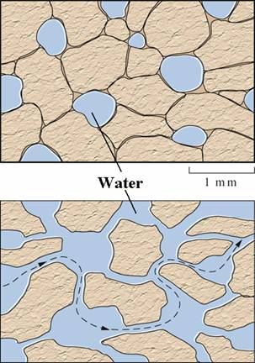
POROUS BUT NOT PERMEABLE
POROUS AND PERMEABLE

Slide 25
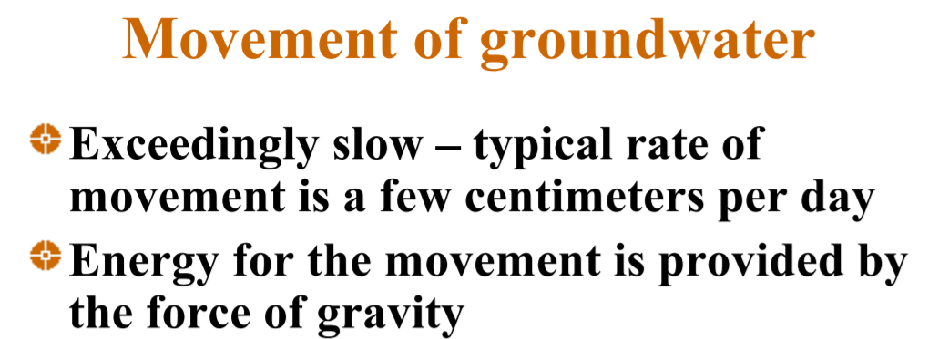
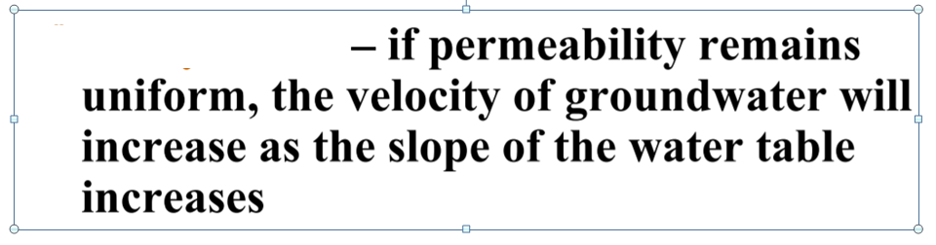

Slide 26
Specific Yield
Specific Yield of soil or rock is the ratio of the volume of water that, after saturation, can be drained by gravity to its own volume
Sy = Wy /V
Sy : Specific Yield
Wy : Volume of water drained
V : Bulk volume of soil or rock

Slide 27
Sy values
Gravel : 23 - 25 %
Sand : 23 – 28 %
Silt : 8%
Clay : 3 %
Limestone : 14 %
Schist : 26 %

Slide 28
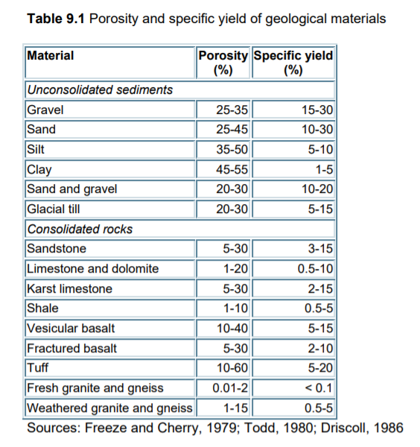

Slide 29
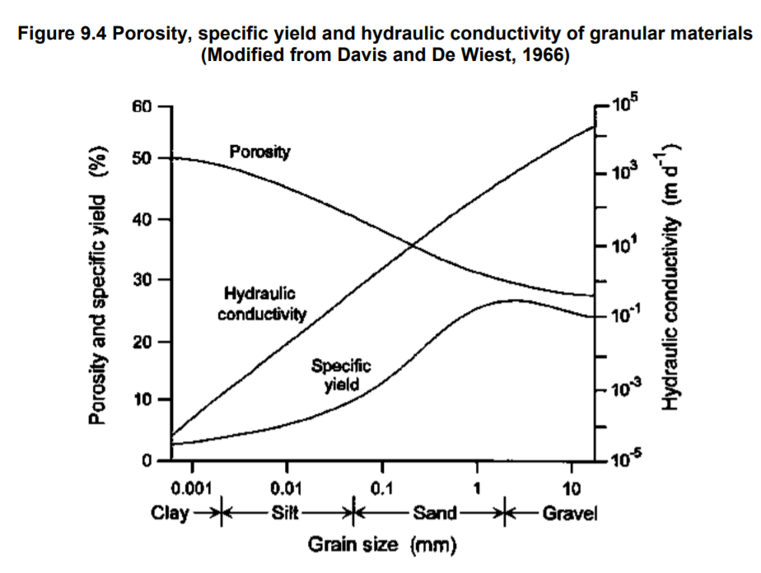

Slide 30
Controls on Specific Yield (Sy)
Specific Yield depends on
Grain size
Shape and distribution of pores
Compaction of the stratum
Time or duration of drainage
Fine grained material yield little water, Where as, coarse grained material yield a substantial amount of water and hence act as potential aquifers

Slide 31
Specific Retention ( Sr)
The Specific Retention of a soil or rock is the ratio of the volume of water it will retain after saturation against the force of gravity to its own volume
Sr = Wr / V
Sr : Specific Retention
Wr : Volume occupied by the retained water
V : Bulk volume of the soil or rock

Slide 32
Wr + Wy = Porosity
(When all pore spaces are interconnecting)

Slide 33
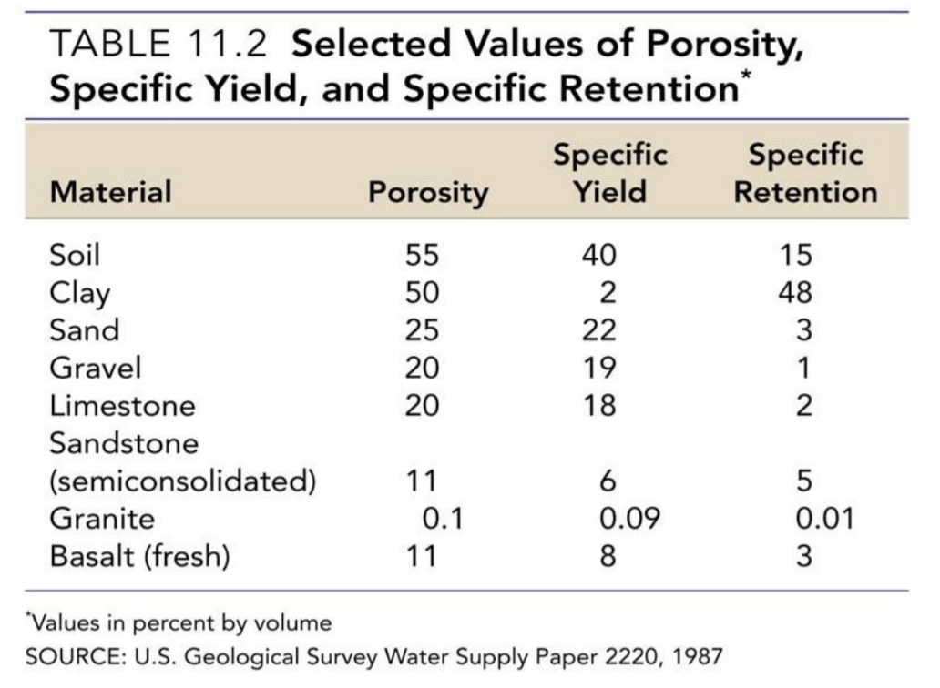

Slide 34
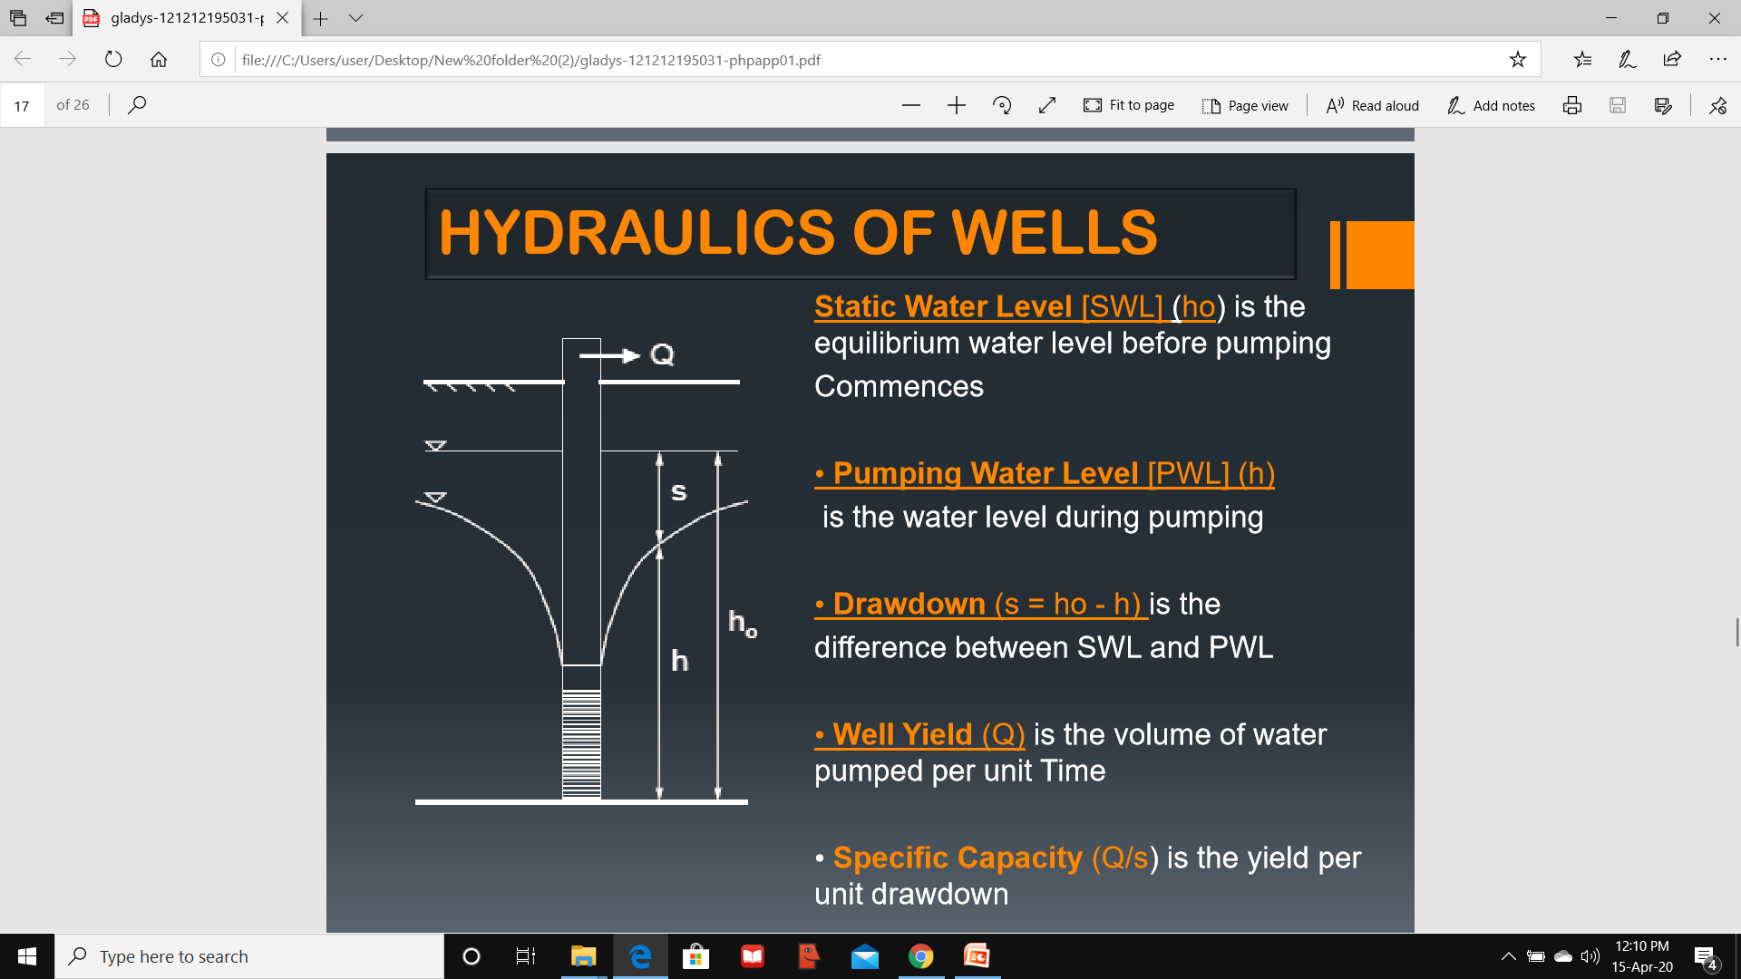
Discharge – Quantity of water that is pumped out
Recovery and Recuperation
Pumping Phase and Recovery Phase

Slide 35
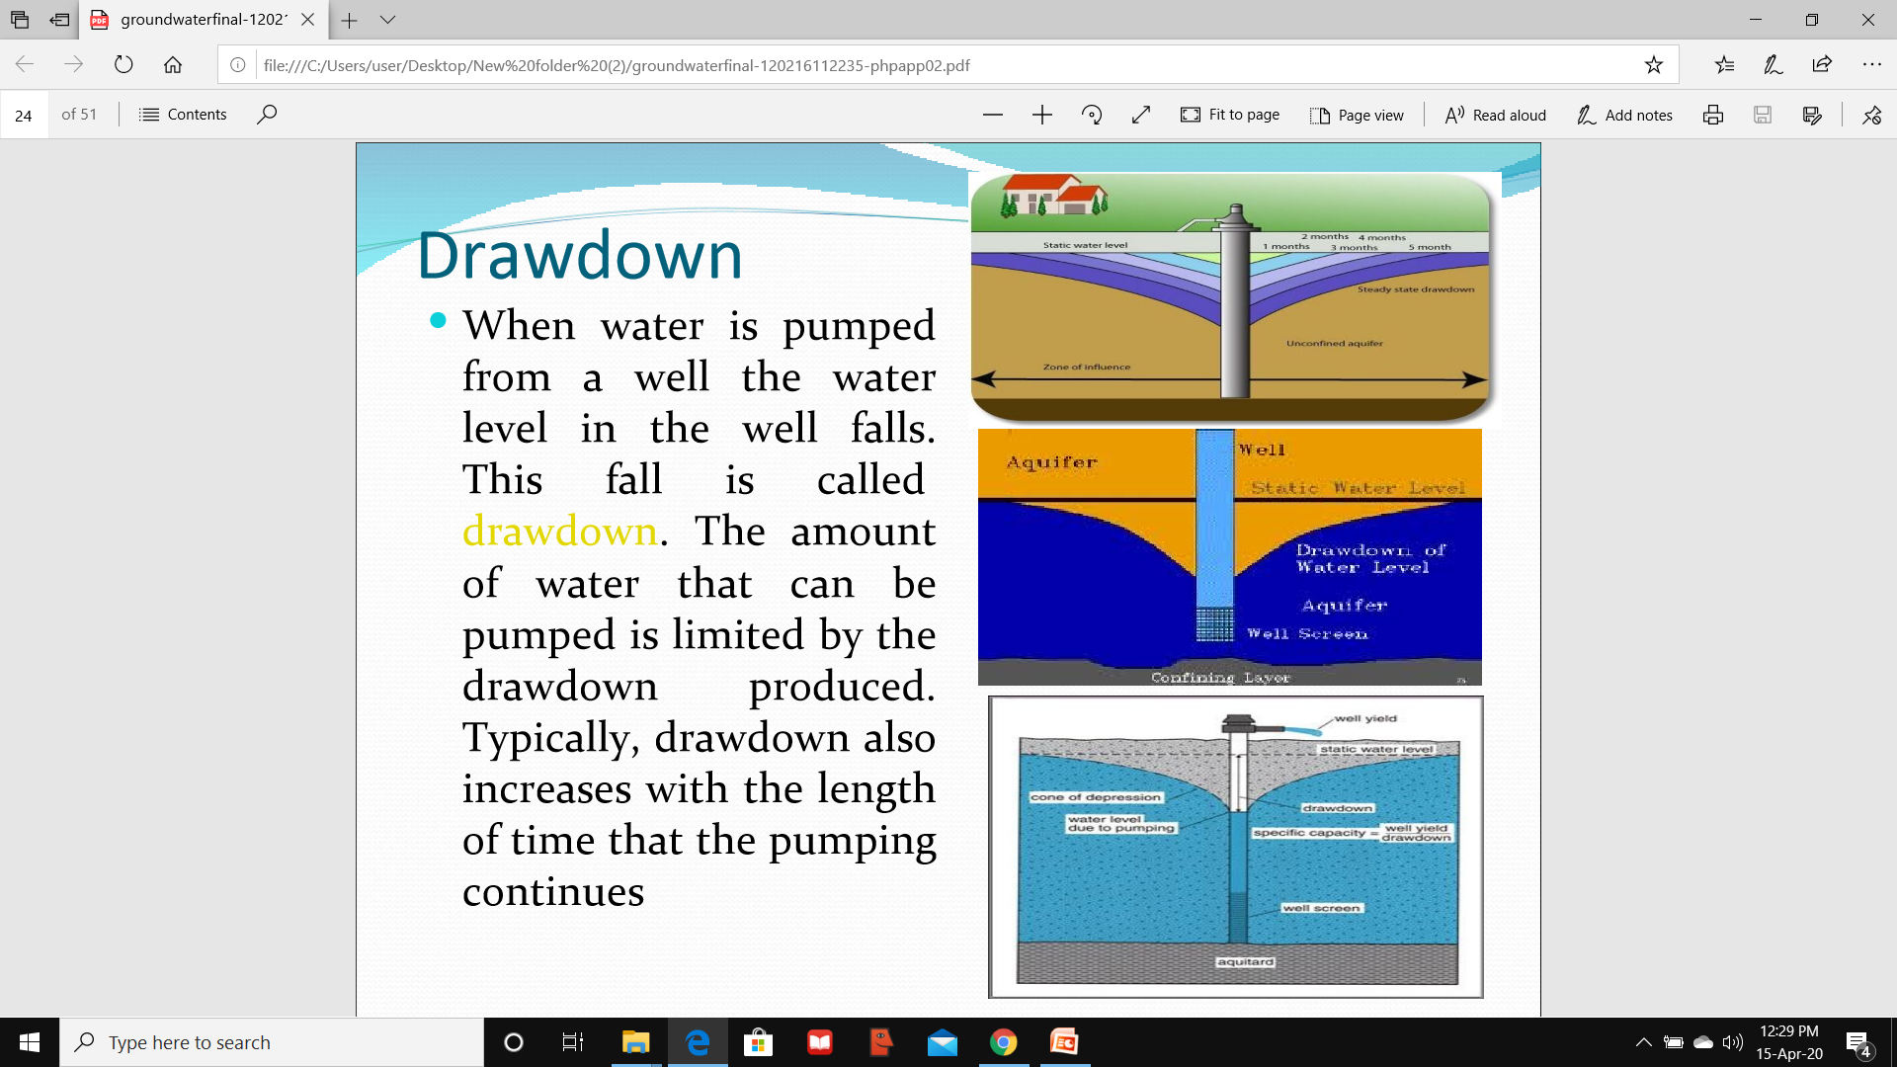
Residual Drawdown
The rise in water level in a well in response to cessation of pumping.

Slide 36
Specific Capacity
Specific capacity of a well is the ratio of discharge to the draw down
Specific Capacity = Discharge/Draw down

Slide 37
Specific Capacity
It is a measure of the productivity of the well
The larger the specific capacity, the better will be the well
Two wells were pumped for extracting same amount of water
20 m³ /5 m = 4 m³ /m and 20 m³ /10m = 2 m³ /m

Slide 38
Controls of Specific capacity
The specific capacity of a well is not constant because it varies with many factors such as :
Length of time since pumping begun
Rate of pumping
Well construction method
Boundary conditions within the aquifer
Influence of nearby pumping well

Slide 39
Various Specific capacity indices
Slichter
Walton
Narasimhan
Singhal
Limaye

Slide 40
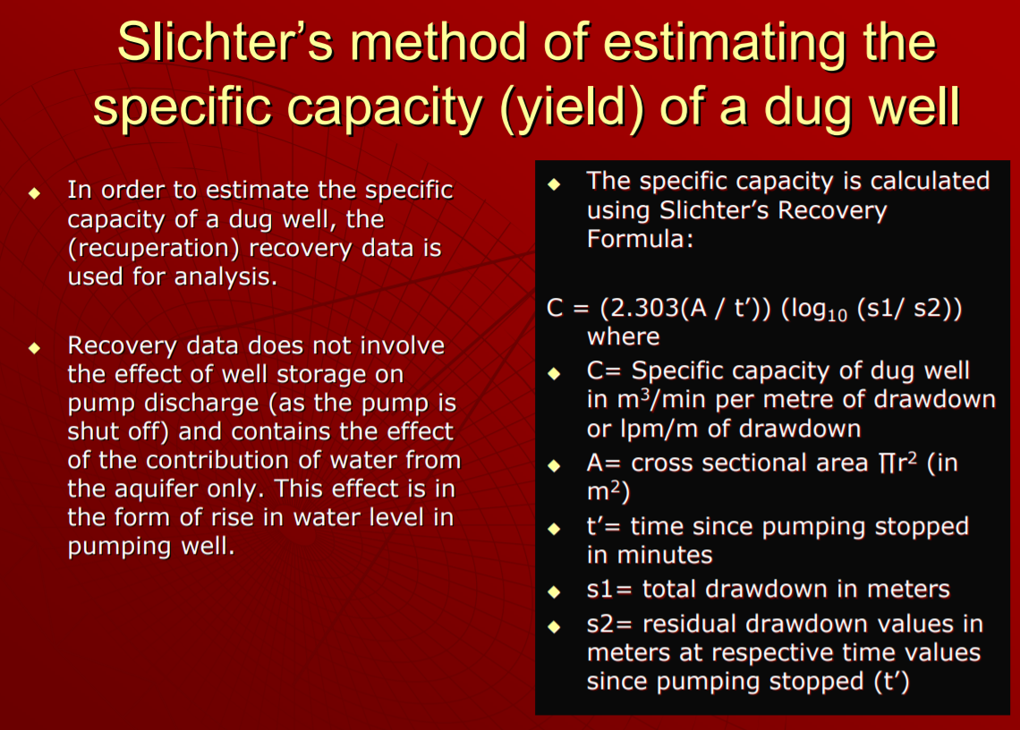

Slide 41
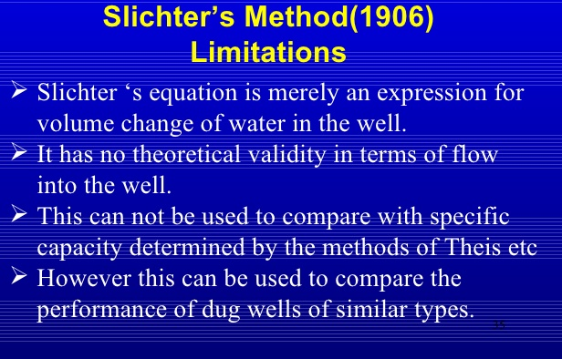

Slide 42
