Slide 1
Pioneers of Stratigraphy
Rajesh Reghunath

Slide 2
There were various isolated speculations on the nature of rocks, minerals and fossils
Fossils → ‘Sports’/ ‘Toys’ of nature that only fortuitously resembled organisms or as the remains of once living plants and animals
Minerals, Ores, Coals, etc → Grow within the earth, periodically mines would be closed down to facilitate the growth
Much or all of the earth’s surficial geology was generally accounted for by the Naachian deluge (great flood) described in the 7th Chapter of ‘Genesis’

Slide 3
Leonardo daVinci (1452-1519)
First scientific explanation about fossils
Fossils shells found high in mountains could not be the result of a universal deluge
The flood could not have carried them there, because they are heavier than water and do not float high in water
Suggested that layered fossils shells in rocks were formed when shelled organisms upon a shore or the bottom of the sea were covered by earth or mud, the mud subsequently petrified, and finally the floor of the sea was uplifted

Slide 4
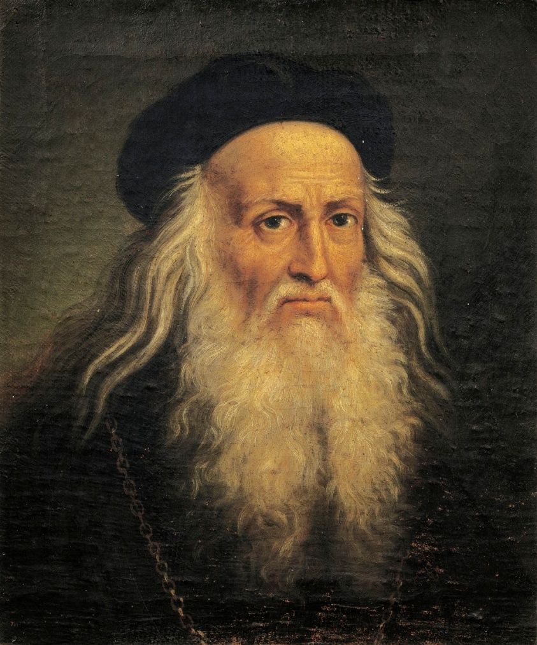
If the God created the earth in a single day (around 4000BC), then all rocks should have the same age
Breakthrough → The discovery that the earth is very old and that rocks can be differentiated on the basis of time

Slide 5
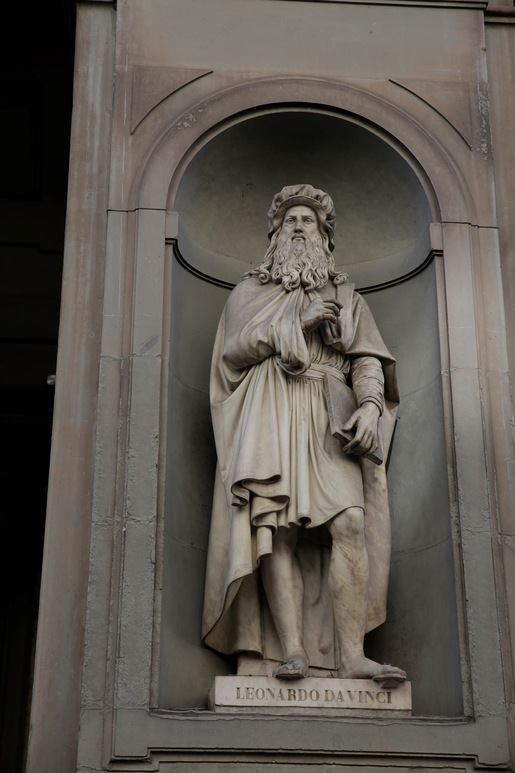

Slide 6
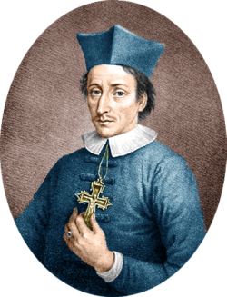
Nicolaus Steno (1638-1686)
Trained in medicine – Anatomy
A catholic bishop at later time
The traditional founding father
of Stratigraphy
Principle of Super Position
Principle of Original Horizontality
Principle of Lateral Continuity
Principle of Crosscutting Relationships

Slide 7
observations
The strata of the Earth are due to the deposits from a fluid
Particles would settle out of a fluid suspension according to their relative weights, the denser and heavier ones first → This differential settling of particles would form horizontal layering (Stratification)

Slide 8
Where and how a stratum formed (eg: in sea or river or desert, etc) could be deduced from an analysis of the particulate matter constituting the rock body → Precursor to modern Sedimentology and palaeo-ecology

Slide 9
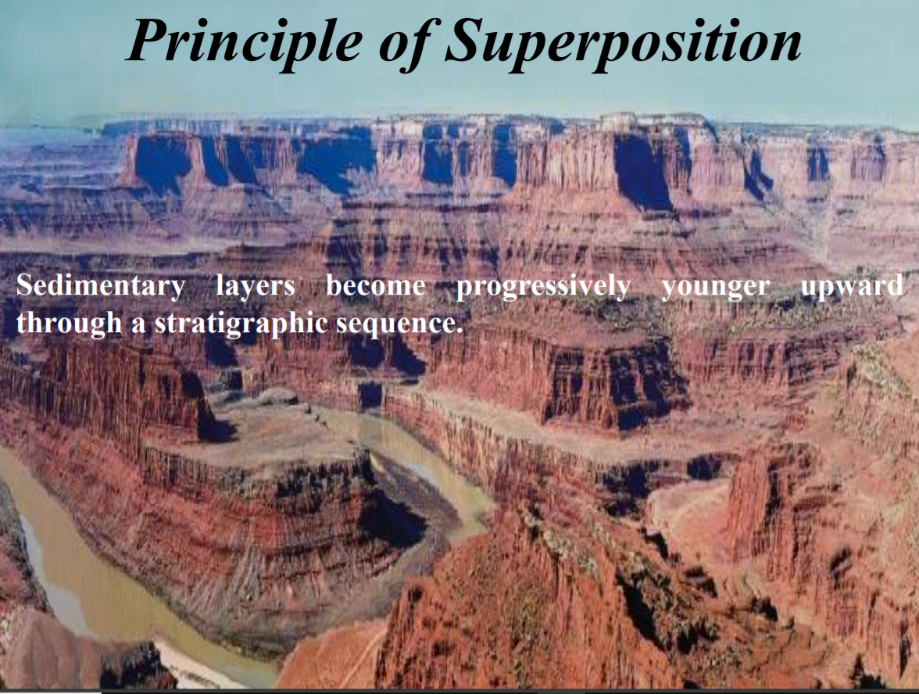

Slide 10
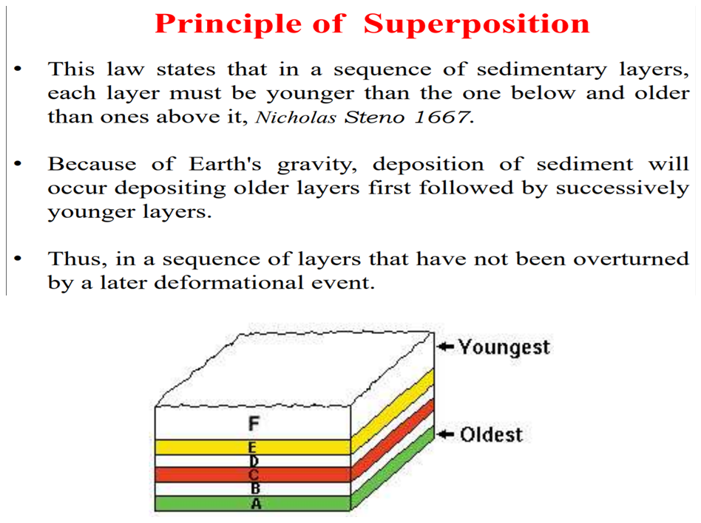

Slide 11
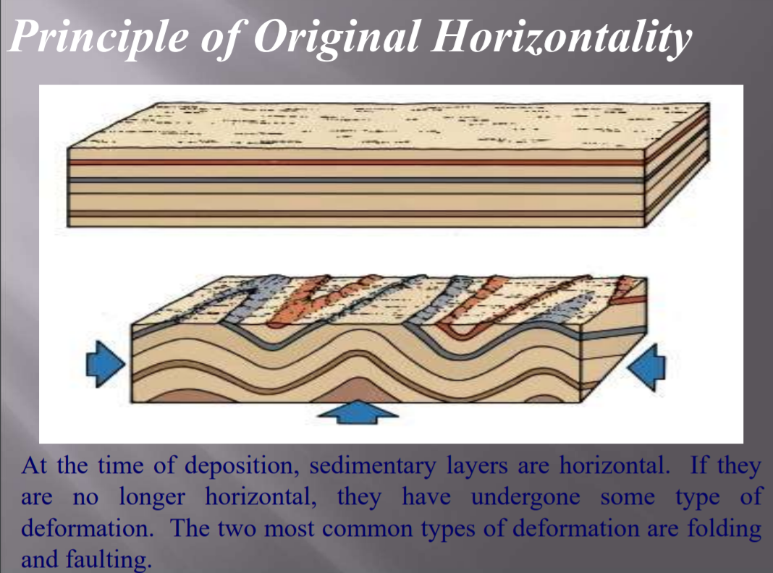

Slide 12
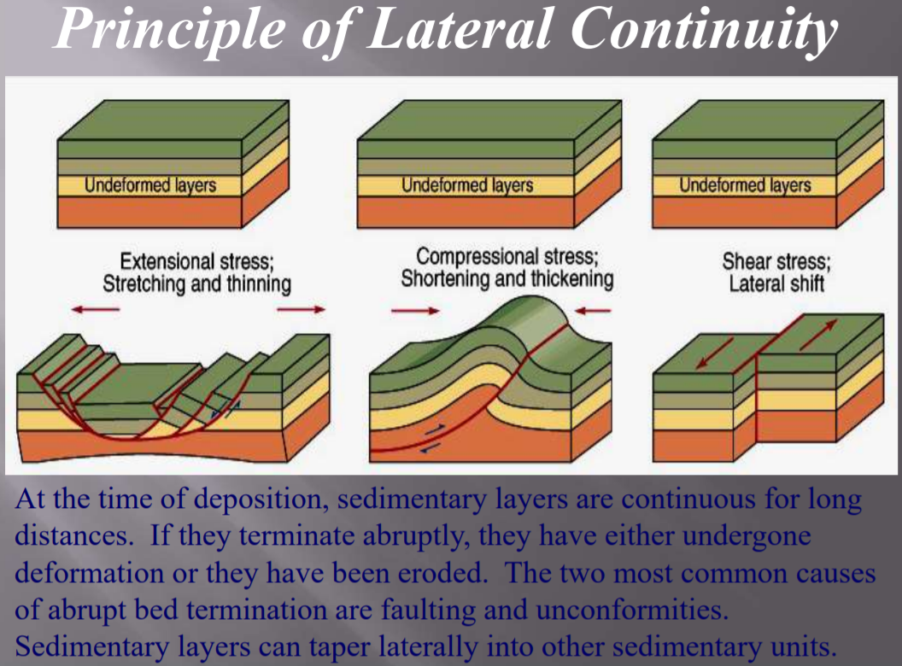

Slide 13
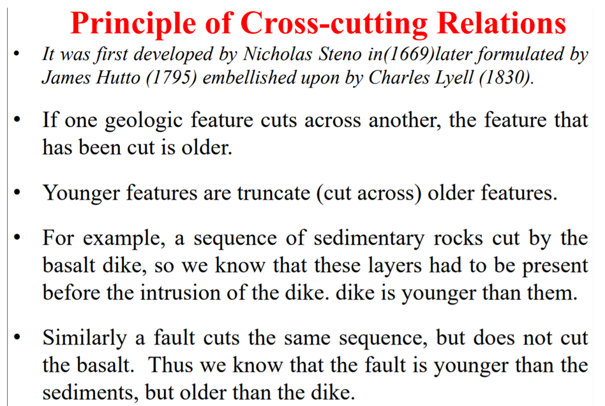

Slide 14
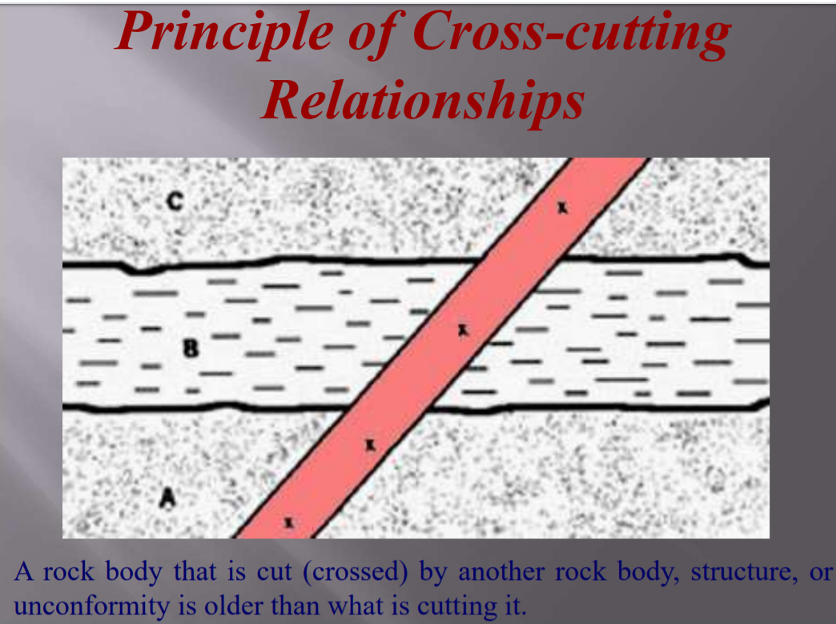

Slide 15
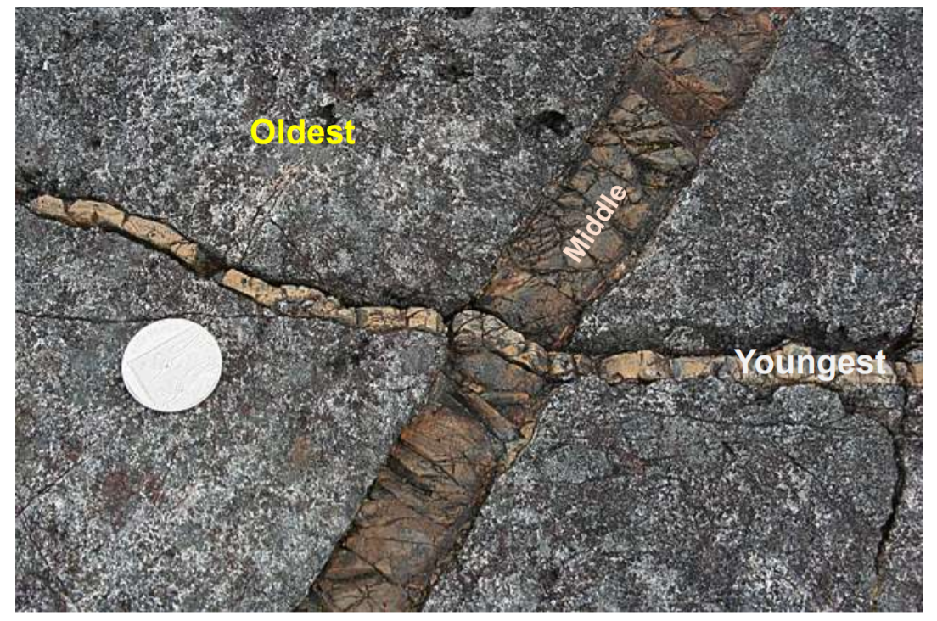

Slide 16
John Wood ward (1665-1728)
Worked mainly on fossils
Observed that throughout the world, terrestrial rocks are arranged in layers or strata ‘divided by parallel fissures’
Suggested that the presently observable strata on the surface of the earth were formed as a result of the Noachion flood, which had churned up and destroyed the surface of the original earth

Slide 17
Held that fossils were the remains of once living organisms that had been destroyed in the flood
According to him, the heaviest substances settle out first from fluids, followed by progressively lighter materials

Slide 18
John Strachey (1671 – 1743)
Used fossils to correlate coal veins that had been offset by a fault.
He also recognized unconformity by using fossils

Slide 19
Robert Hooke ( 1635 – 1703)
Suggested that fossils could be used to determine geologic chronology

Slide 20
Antonio Lazzaro Moro (1687-1764)
MOne of the founders of “vulcanism,” the idea that volcanoes have played an important role in shaping the face of the earth.
Distinguished two major classes of mountains and rocks.
The older mountains consists exclusively of massive, non stratified rocks
The younger mountains are composed of either stratified rocks or stratified rocks overlying non-stratified rocks.
He suggested volcanic activity for the observed stratification.
He expected fossils in the layered rocks

Slide 21
Giovanni Arduino (1713-1795)
Suggested a four fold classification for mountains and their associated rocks
Primary Mountain → Composed of rocks that often contain metal ores but lacks fossils
Secondary Mountain→ Well lithified, bedded rocks containing marine organisms
Tertiary Mountain → are low mountains or hills that consist of predominantly unconsolidated sediments (gravels, sand, clays, etc) and may be associated with volcanically produced rocks
Final One → Most Recent – Strata consist of materials evolved from the above three types of mountains and deposited loosely on the surface of the earth

Slide 22
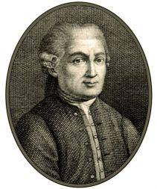
He divided the history
of the Earth into four periods:
Primitive
Secondary
Tertiary and Volcanic
Quaternary

Slide 23
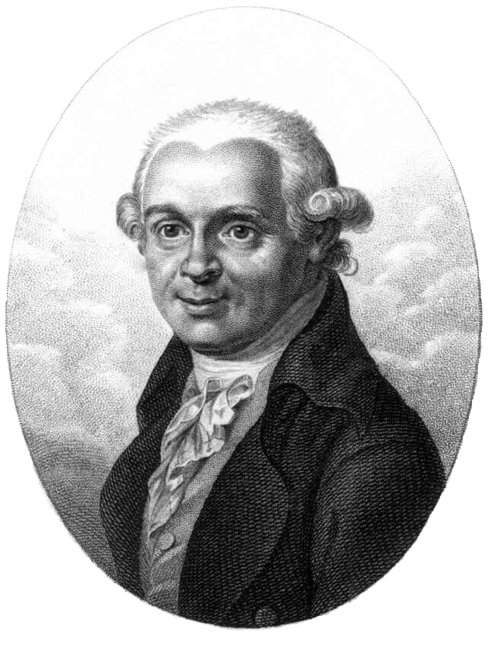
Abraham Gottlob Werner (1750-1817)
Greatest figure in Geology toward the close of the 18th centaury and the arch villain of modern Geology, a man who retarded geologic progress
Was very influential
Could force his opinions to others
Belong to the Neptunian school of thought

Slide 24
Believed that originally the earth was covered entirely by a primeval ocean from which originated almost all rocks due to the retrieval of the ocean
Initially granite and other non fossilliferous rocks crystallized out of the ocean
Next originated transitional series of rocks → graywacke, mica, slate, lime stone with few fossils
Third → Stratified rocks, sedimentary and fossilliferous

Slide 25
Fourth → Derivative rocks of poorly consolidated sands, gravels and clays derived from the erosion of the previously formed rocks
Lastly → Volcanic rocks – due to the natural burning of coal seams
Werner argued that the mountains were the original topographic feature of the primitive earth, perhaps formed as the first granite crystallised from the universal ocean
Mountains were not formed due to upliftment

Slide 26
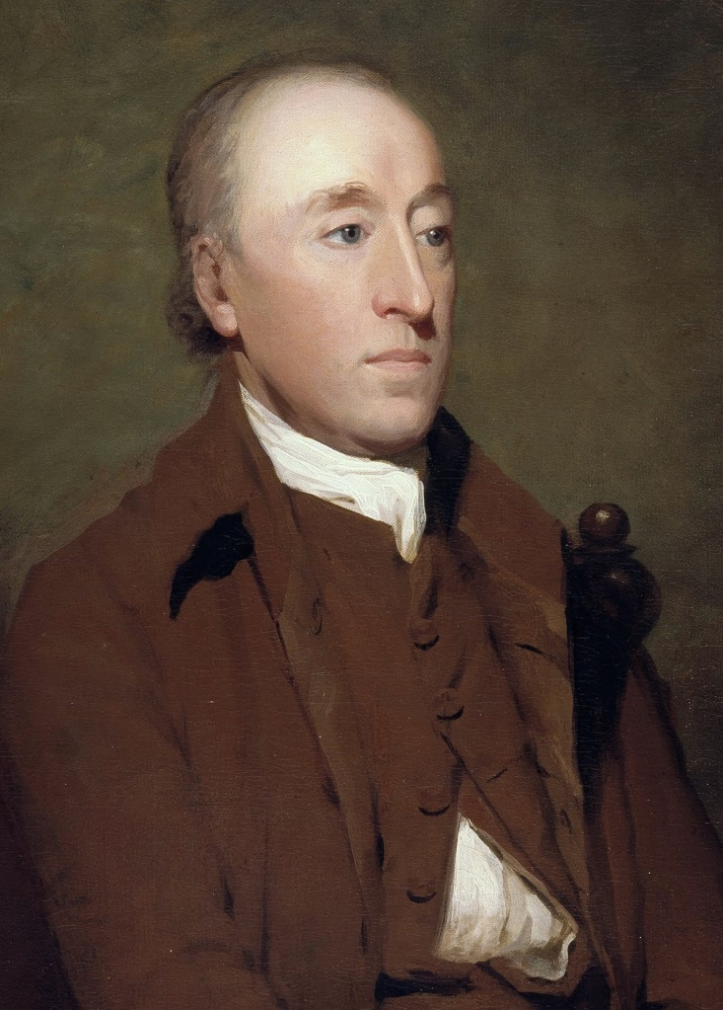
James Hutton (1726 – 1797)
Physician by training, Farmer by practice
“Prior to Hutton, Geology did not existed”
Founding father of modern Geology
Credited with the formulation of three basic concepts
  The vastness of geologic time
  Unconformities
  Uniformitarianism (Present is the key to the past)

Slide 27
Uniformitarianism
The geologic processes that occurred in the past can be explained by current geologic processes
Geologists estimate that Earth is about 4.6
billion years old, an idea that was first
proposed by James Hutton in the 18th century.
Hutton theorized that the same forces that change
Earths surface now, such as volcanism and
erosion, are the same forces that were at work in
the past.

Slide 28
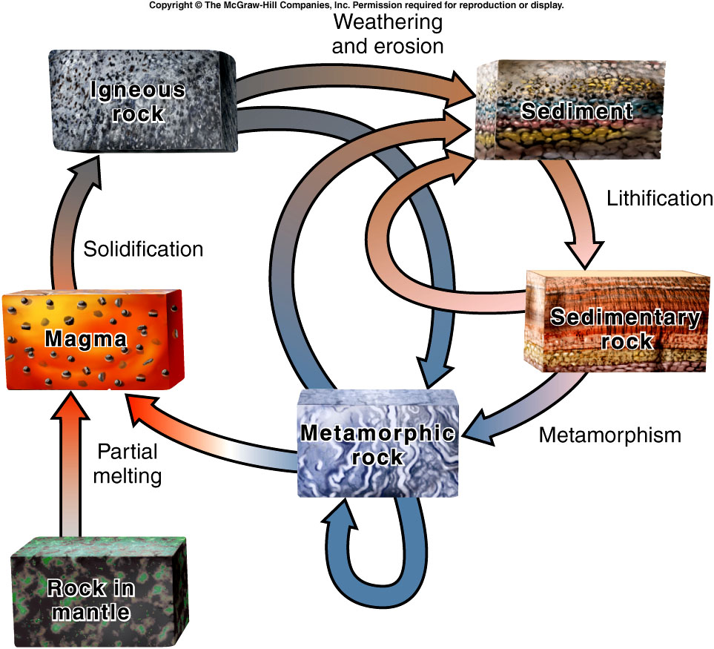
Developed the concept of rock cycling
Solid rock →Weathering → Soil →Erosion → Transportation → Deposition in basins → stratification → consolidation → Formation of rocks → Uplifting → Again source for weathering
Hutton speculated that the earth has gone through a number of rock cycles

Slide 29
Sediment fusion : as a result of heat and pressure
Granite → is of magmatic origin
Time is indefinitely long →
  by examining weathering rates of rocks
  the lack of significant changes in coastlines since Roma times

Slide 30
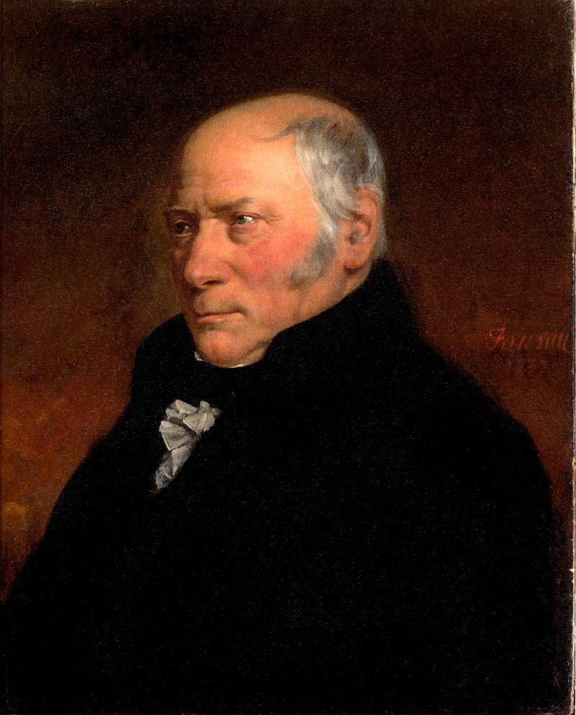
William Smith (1769- 1839)
Was a Surveyor – surveyed canals, mines , quarries, etc
Suggested that any particular formation or stratum has a lateral geographic continuity and could be mapped
Believed that fossils can be used for dividing the strata as well as for correlating two strata

Slide 31
Produced a complete succession of rocks of Bath region → with details of lithologies, structures, fossils, etc. → First of such kind
First to identify the applications of Geology on other fields -- agriculture, forestry, mining, canal, & road construction, Irrigation, well construction, etc

Slide 32
Charles Lyell (1797 – 1875)
Lawyer in the initial career
His theories closely resembles those of James Hutton
He envisaged a steady state but cyclical world → Same processes operated in the past. No additional processes in the past or at present
No secular trend in the Earth’s history
Same proportions of the ocean and continents through out the age

Slide 33
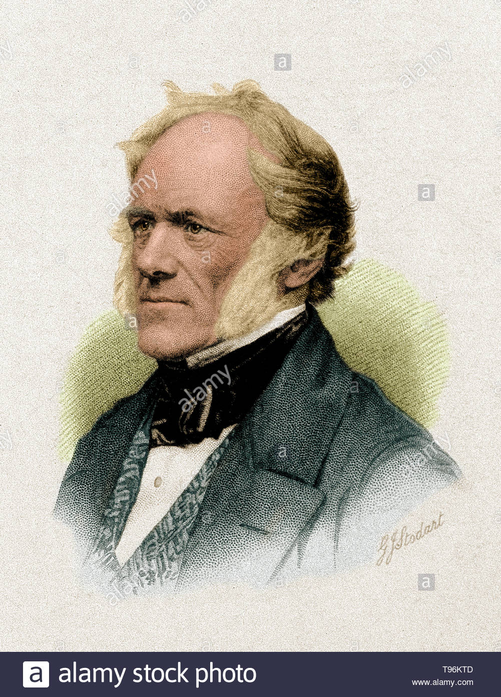
Argued that Earth contained same number of species → Newer ones would replace the extinct one
Advocated the principle “present is the key to the past” in a narrower way
Appreciated the use of fossils in organizing rocks → subdividing, correlating, etc

