Slide 1
Principles of
Stratigraphy
Omer M. Ahmed
MSc, 2nd Year, 2016
University of Kerala, India.

Slide 2
Introduction
Stratigraphy is the study of strata (sedimentary layers) in the Earth's crust, it is the relationship between rocks and time.
Stratigrapher are concerned with the observation, description and interpretation of direct and tangible evidence in rocks to determine the history of the Earth.
The combination of sedimentology and stratigraphy allows us to build up pictures of the Earth’s surface at different times in different places and relate them to each other through the relative ages of rocks

Slide 3
A more modern way of stating the same principle is that the laws of nature (laws of chemistry and physics) that have operated in the same way since the beginning of time.
And thus if we understand the physical and chemical principles by which nature operates, we can assume that nature operated the same way in the past.

Slide 4
Basic principles of stratigraphy
  Principle of Uniformitarianism
  Principle of Lateral Horizontality
  Principle of Superposition
  Principle of Cross-cutting Relations
  Principle of Inclusions
  Principle of Chilled Margins
  Correlation

Slide 5
1: Principle of Uniformitarianism
Was postulated by James Hutton (1726-1797)
He examined rocks in Scotland and noted that features like mud cracks, ripple marks, graded bedding and so on. where the same features that could be seen forming in modern environments, and that past geologic events can be explained by phenomena and forces observable today
Hutton concluded that processes are currently operating on the Earth must be the same processes that operated in the past.
Later on stated as "the present is the key to the past".

Slide 6
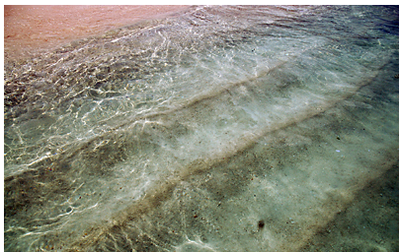

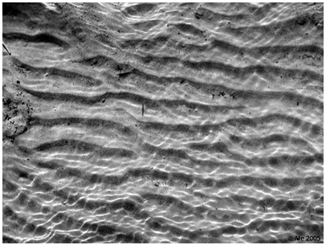
Present
Past

Slide 7
2: Principle of Lateral Horizontality
Sedimentary strata are deposited in layers that are horizontal or nearly horizontal, parallel to the Earth's surface, Nicholas Steno (1638–1686).
Sediments deposited on steep slopes will be washed away where as if they deposited in nearly horizontal layers can be buried and lithified.
Thus rocks that we see them now inclined or folded have been disturbed since their original deposition.

Slide 8
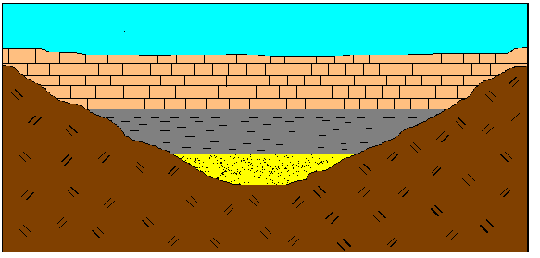

Slide 9
3: Principle of Superposition
This law states that in a sequence of sedimentary layers, each layer must be younger than the one below and older than ones above it, Nicholas Steno 1667.
Because of Earth's gravity, deposition of sediment will occur depositing older layers first followed by successively younger layers.
Thus, in a sequence of layers that have not been overturned by a later deformational event.

Slide 10
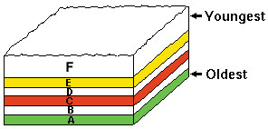

Slide 11
4: Principle of Cross-cutting Relations
It was first developed by Nicholas Steno in(1669)later formulated by James Hutto (1795) embellished upon by Charles Lyell (1830).
If one geologic feature cuts across another, the feature that has been cut is older.
Younger features are truncate (cut across) older features.
For example, a sequence of sedimentary rocks cut by the basalt dike, so we know that these layers had to be present before the intrusion of the dike. dike is younger than them.
Similarly a fault cuts the same sequence, but does not cut the basalt. Thus we know that the fault is younger than the sediments, but older than the dike.

Slide 12
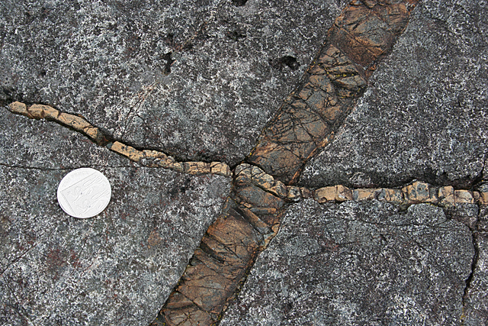
Oldest
Middle
Youngest

Slide 13
5: Principle of Inclusions
If we found a rock fragment enclosed within another rock, we say the fragment is an inclusion.
The inclusions had to be present before they could be included in the younger rock, they always represent fragments of an older rock.
If the enclosing rock is an igneous rock, the inclusions are called xenoliths.
This principle is often useful for distinguishing between a lava flow and a sill.

Slide 14
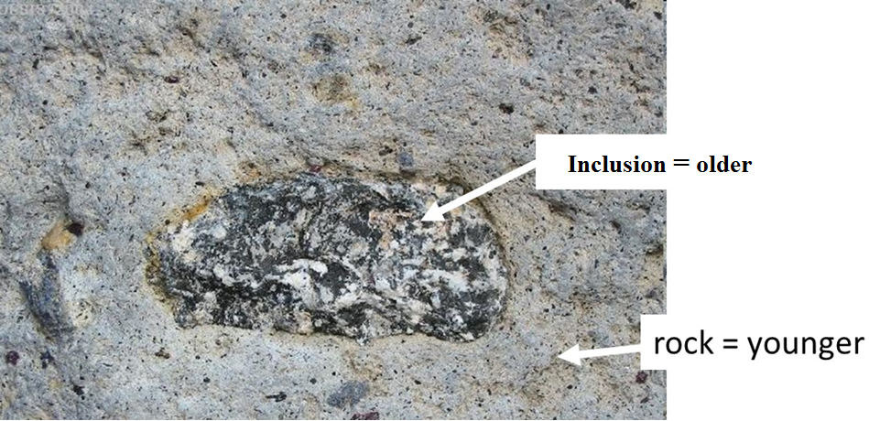

Slide 15
6: Principle of Chilled Margins
When a hot magma intrudes into cold country rock, the magma along the margins of the intrusion will cool more rapidly than the interior.
Fine grained rock or glassy rock will be along the margin where as coarser grained will occur farther away from the margin.
Chilled margins younger than surrounding rock because the surrounding rock had to have been there first in order to cause the cooling effect.
When magma comes in contact with soil or soft rock, heating up result in a baked zone in the surrounding rock near the contacts with the igneous body.

Slide 16
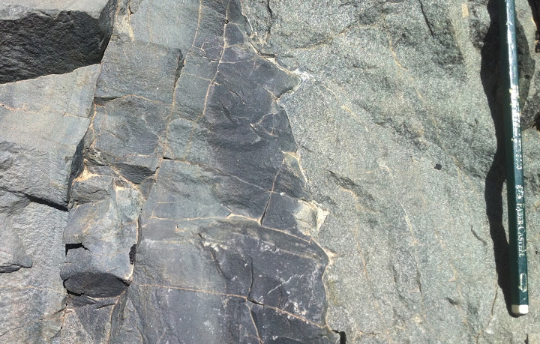
Coarse grain
Fine grain

Slide 17
7: Correlation
Determining time equivalency of rock units.
Rock units may be correlated within a region, a continent, and even between continents.
Based on matching physical features such as rock unit, similar rock types (marker beds, coal seams, rare minerals, odd, color…).
Fossils represent living creatures that have evolved through time, so when we found a fossil of the same type in two different areas (sections) that are not laterally continuous, we are pretty sure that the rocks are about the same age.

Slide 18
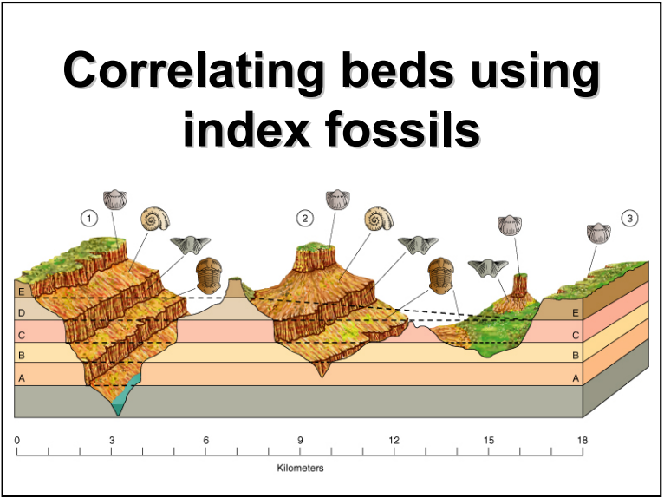

Slide 19
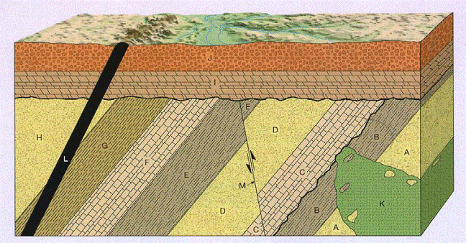
CONCLUSION
Principles of stratigraphy are geological tools that helps in determine the relative age, numbers of existing events, field relations and that can be estimated from one out crop or from different.

Slide 20
REFERENCES
Gary Nichols (2009), sedimentology and stratigraphy, A John Wiley & Sons, Ltd., Publication, 2^{ed,} 419 p.
Maurice E.Tucker (2003), Sedimentary Rocks in the Field, John Wiley & Sons Ltd, 237 P.
http://www.geologyin.com

Slide 21
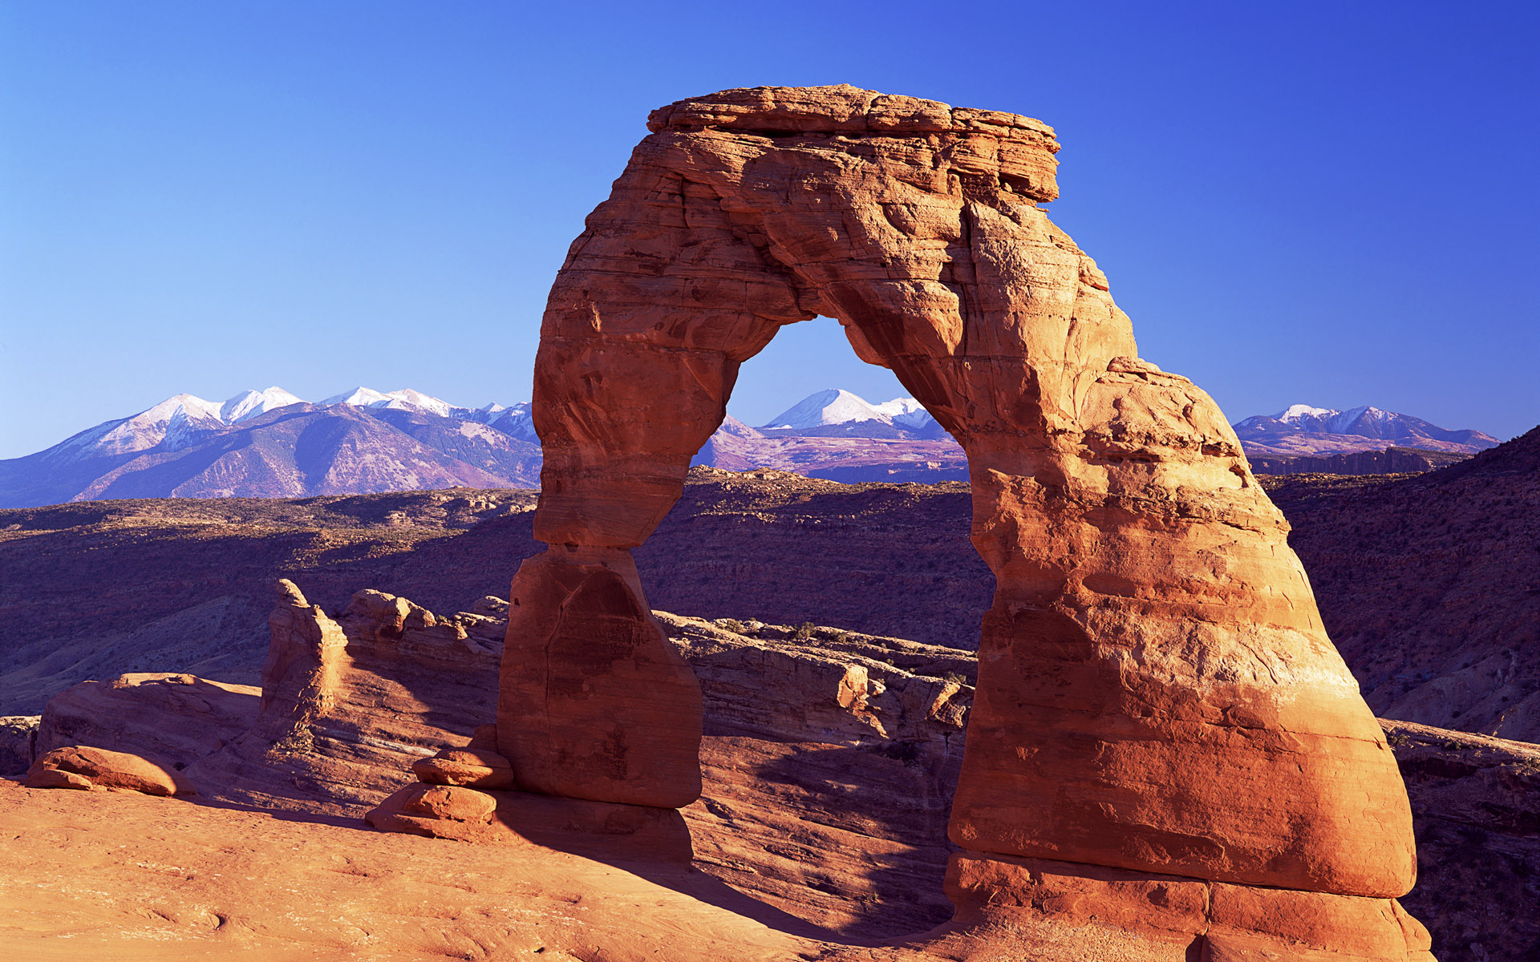
Thank
You

