Slide 1
THE HYDROLOGIC CYCLE
DR.RAJESH REGHUNATH

Slide 2
THE HYDROLOGIC CYCLE
The continuous movement of water from one reservoir to another
It is the endless circulation of water

Slide 3
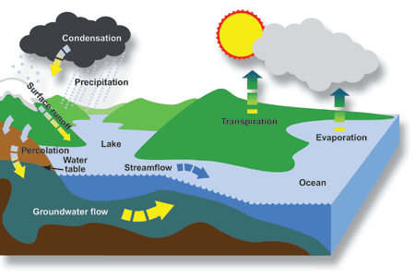
THE HYDROLOGIC CYCLE

Slide 4
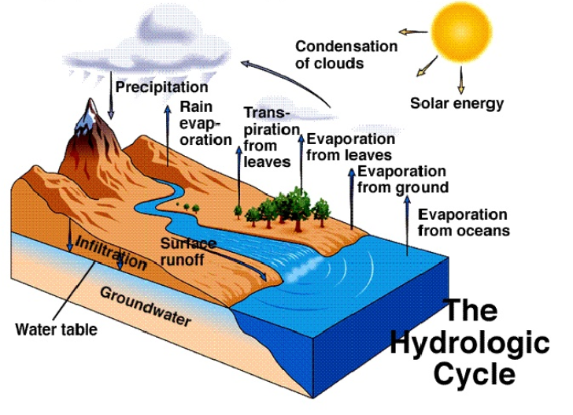

Slide 5
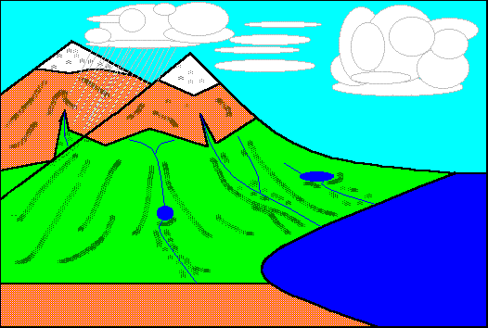

Slide 6
The endless circulation has neither
beginning nor end
Hydrologic cycle is natural machine, a
constantly running distillation and
pumping system
Driving force/ energy → Sun’s energy
and gravity

Slide 7
Hydrologic cycle essentially composed
of three major systems
Ocean – Source of water
Atmosphere – Deliverer of water
Land – User of water
On a global level the hydrologic cycle
is a closed system, but on a local
level it is an open system

Slide 8
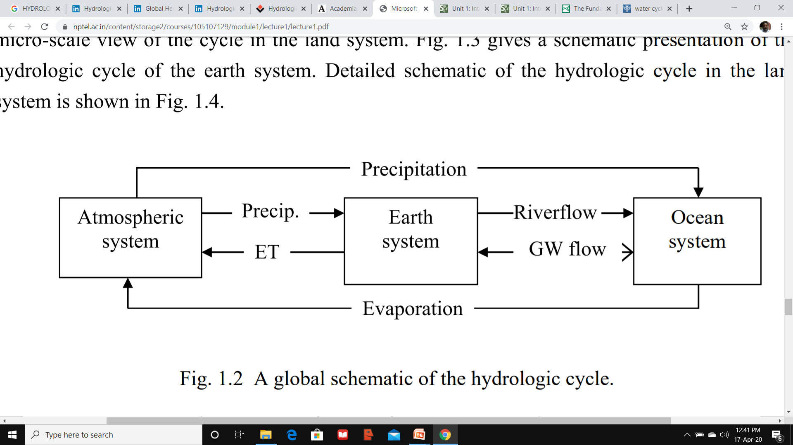
Tidal Flow
Sea Level rise
Sea water intrusion

Slide 9
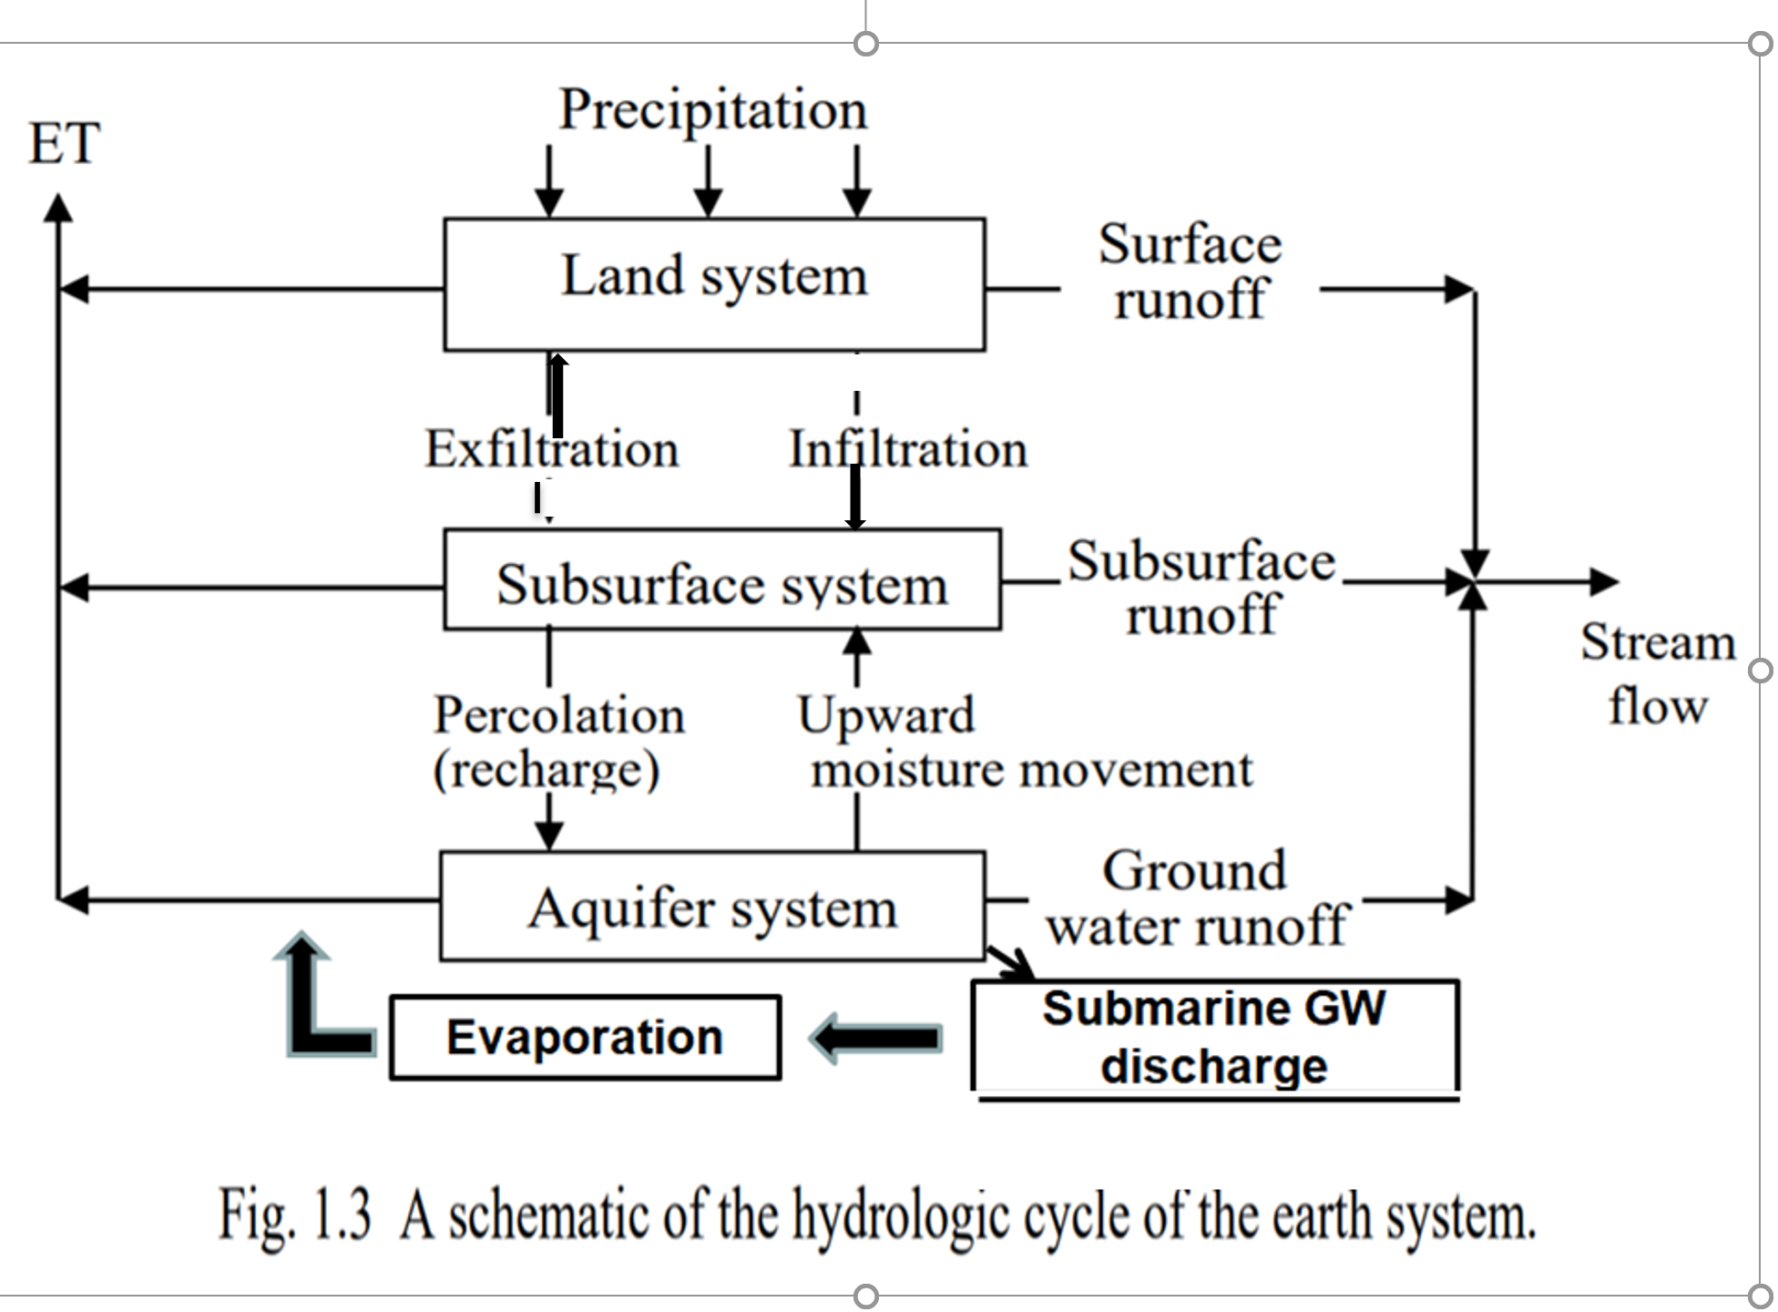

Slide 10
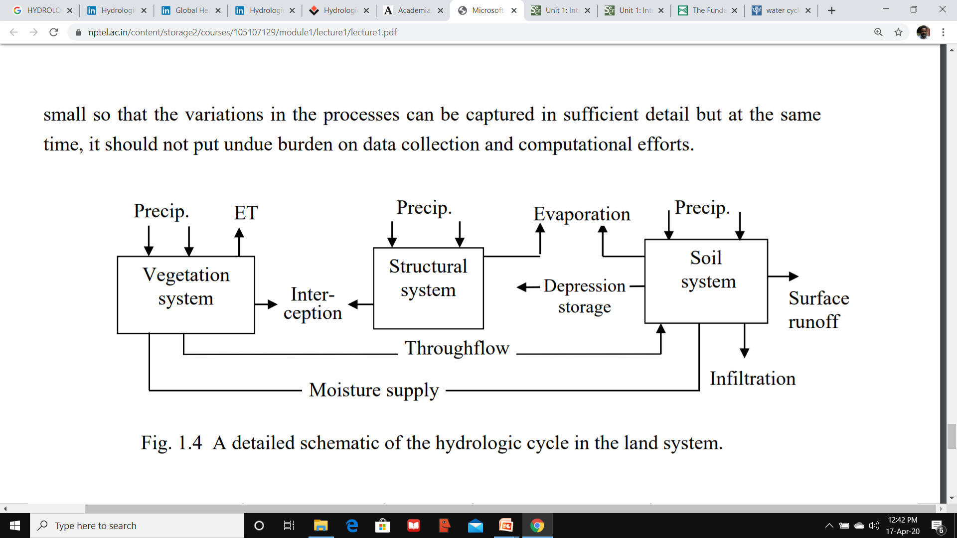

Slide 11
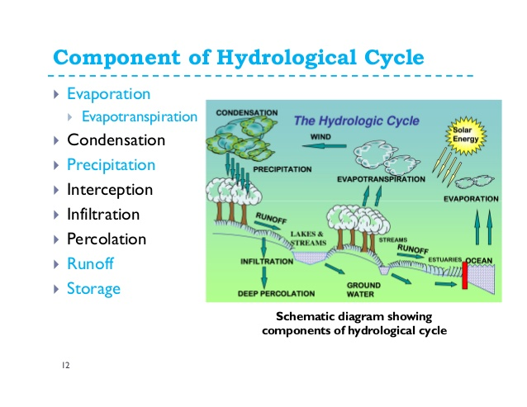

Slide 12
PRECIPITATION
Precipitation is the form of rain, snow
and hail comes from clouds
When the clouds rise over mountain ranges, they cool, becoming so saturated with water that water begins to fall as rain, snow or hail, depending on the temperature of the surrounding air

Slide 13
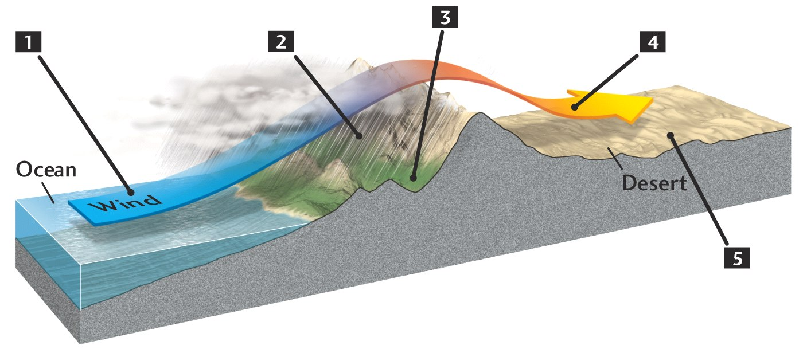
Formation of Rain Shadow Deserts
Moisture laden winds come onshore.
Figure 13.3

Slide 14
Formation of Rain Shadow Deserts
Moist airmass rise and cool, causing precipitation…
Moisture laden winds come onshore.
Figure 13.3

Slide 15
Formation of Rain Shadow Deserts
Moist airmass rise and cool, causing precipitation…
…resulting in a rainy windward slope.
Moisture laden winds come onshore
Figure 13.3

Slide 16
Formation of Rain Shadow Deserts
Moisture-depleted airmass sink and warm, reducing relative humidity…
Moist airmass rise and cool, causing precipitation…
…resulting in a rainy windward slope
Moisture laden winds come onshore
Figure 13.3

Slide 17
Formation of Rain Shadow Deserts
Moisture-depleted airmass sink and warm, reducing relative humidity…
Moist airmass rise and cool, causing precipitation…
…resulting in a rainy windward slope
Moisture laden winds come onshore
…forming a
rain shadow on the
leeward side of the mountains.
Figure 13.3

Slide 18
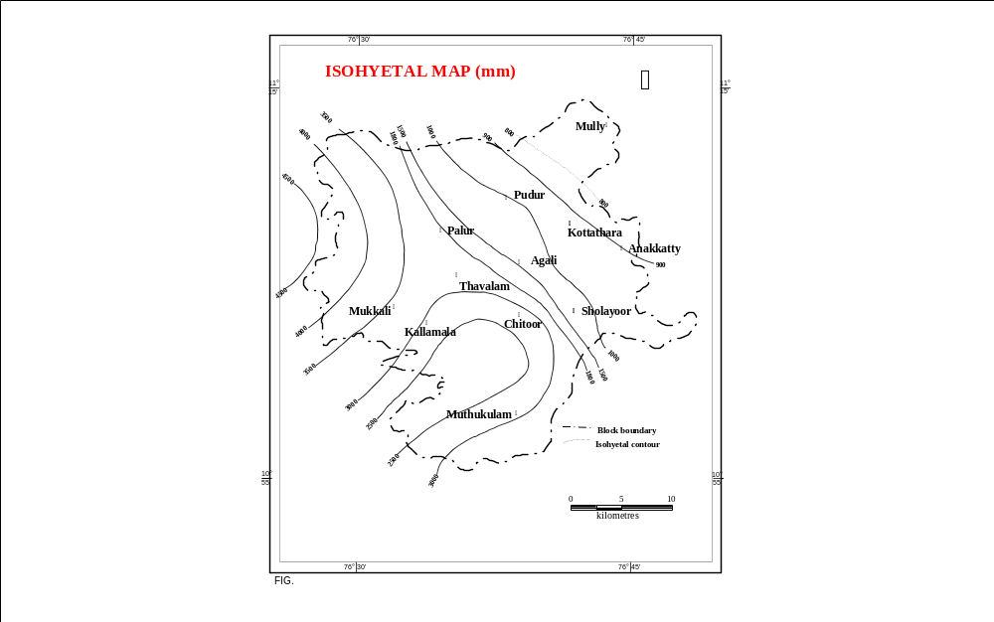
After CWRDM

Slide 19
EVAPORATION
As water is heated by the sun, its surface molecules become sufficiently energized to break the attractive force binding them together, and then evaporate and rise as invisible vapour in the atmosphere

Slide 20
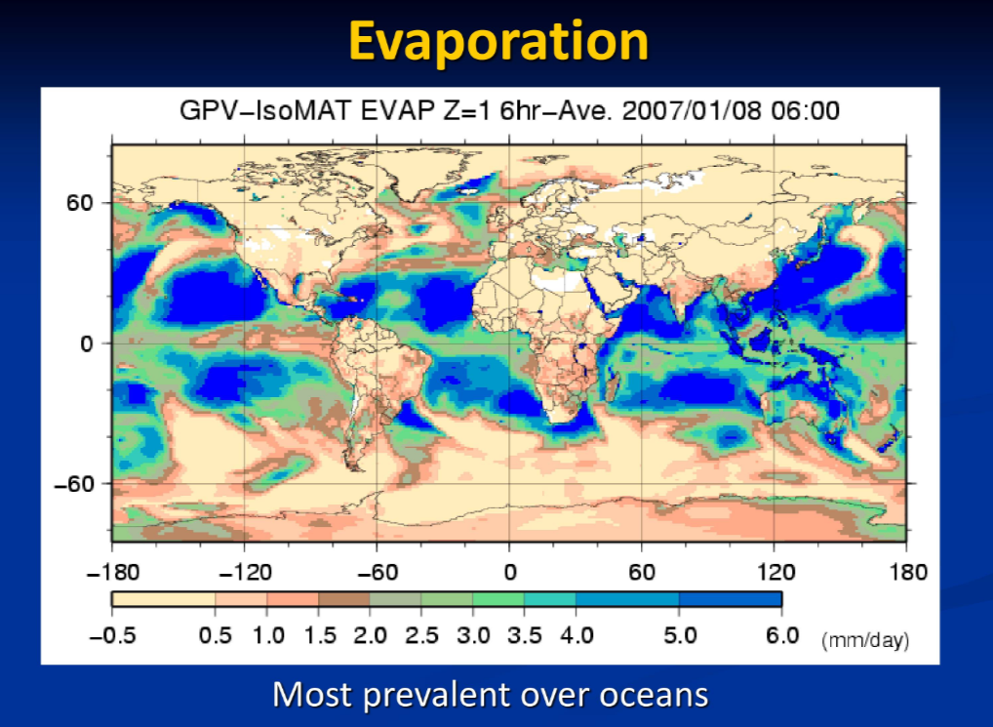

Slide 21
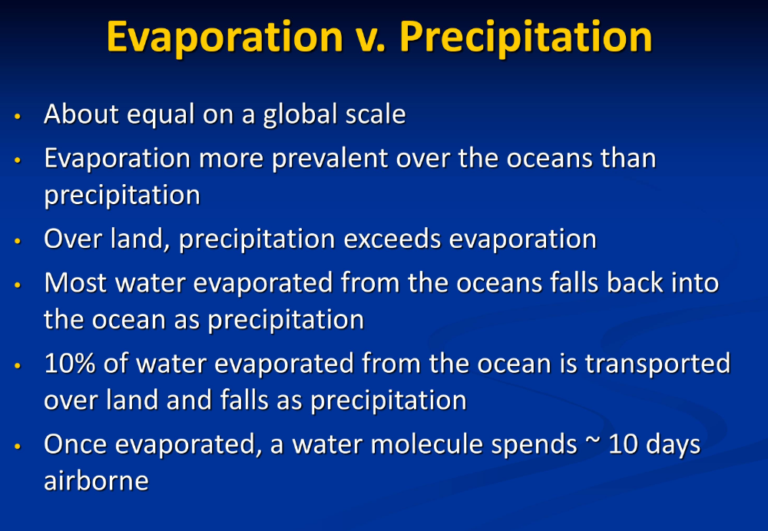

Slide 22
TRANSPIRATION
Water vapour is also emitted from plant leaves by a process called transpiration
Every day an actively growing plant transpires 5 to 10 times as much water as it can hold at once

Slide 23
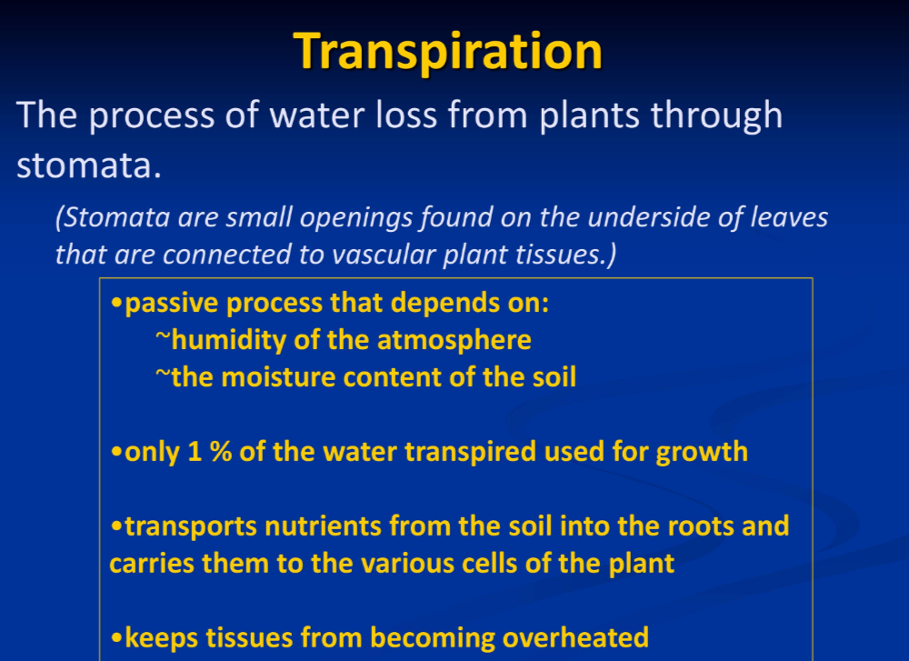

Slide 24
CONDENSATION
As water vapour rises, it cools and eventually condenses, usually on tiny particles of dust in the air. These tiny particles then collate and form clouds
When it condenses it becomes a liquid again (rain) or turns directly into a solid (ice, hail or snow)

Slide 25
RUNOFF
Excessive rain or snowmelt can produce overland flow to creeks and ditches
Runoff is visible flow of water in rivers, creeks and lakes as the water stored in the basin drains out

Slide 26
PERCOLATION AND INFILTRATION
Some of the precipitation and snow melt moves downwards, percolates or infiltrates through cracks, joints and pores in soil and rocks until it reaches the water table where it becomes ground water

Slide 27
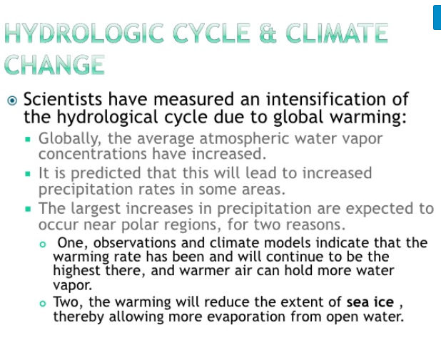

Slide 28


Slide 29
