Slide 1
CONJUNCTIVE USE Of
WATER RESOURCES
Dr.Rajesh Reghunath

Slide 2
MINING YIELD
The condition where the groundwater is withdrawn at a rate exceeding the recharge
Results in the
drying up of the well,
deepening of the well,
more powerful lifting mechanisms ,
more investment
Counter Argument → Water in storage is of no value unless it is used

Slide 3
Undesired effects of the Mining Yield
Progressive reduction in the volume of the water source in the aquifers
Development of uneconomic pumping conditions
Degradation of groundwater quality
Interference with the prior water rights
Land subsidence due to emptying of pore spaces

Slide 4
PERENNIAL YIELD
Perennial yield is that rate at which water can be withdrawn perennially under specific operating conditions without producing an undesired result
Overdraft → Any draft in excess of perennial yield.
Overdraft brings negative impacts in the environmental, social and economic conditions

Slide 5
MAXIMUM PERENNIAL YIELD
The maximum quantity of groundwater perennially available if all possible methods and sources are developed for recharging the basin.
So when more water is used for recharging, the maximum perennial yield will be increased

Slide 6
DEFERRED PERENNIAL YIELD
Consist of two different pumping rates
The initial rate is larger and exceeds the perennial rate, thereby reducing the groundwater level to a prefixed depth
This extracts the water which will be wasted as base flow, evaporation, transpiration, etc
After it is lowered to a predetermined depth, a second rate which is comparable to the perennial yield will be established

Slide 7
CONJUNCTIVE USE OF ALL WATER SOURCES
A better concept for basin management
This involves the co-ordinated and planned operation of both surface water and groundwater resources to meet the water requirement in a manner whereby water is conserved
It is a conjunctive use of both surface water and groundwater

Slide 8
The basic difference with the conventional management of water resources is that the groundwater reservoirs will be developed by planned extraction of groundwater during the periods of low precipitation, while subsequent replenishment can be made during the periods of surplus surface supply.
During the periods of above normal pption, surface water is utilised to the maximum extent possible and also used to artificially recharge into the underground to augment groundwater storage and raise the groundwater level.

Slide 9
There must be space to store the recharged water in the aquifer
The aquifer should have sufficient Transmissivity to transmit the recharged water to other regions
During the drought periods, limited surface water resources are supplemented by pumping groundwater, thereby lowering the groundwater levels

Slide 10
REQUIREMENTS
Require competent personnel
Detailed knowledge about the hydrogeology of the basin
Records of pumping and recharge rates
Details of aquifer parameters and geometry
Spatial, seasonal and temporal behaviour of the groundwater body
Data on
  surface water resources
  geologic conditions
  water distribution system
  water demand on various sectors
Waster water disposal
Continuous updating of information on groundwater level & quality

Slide 11
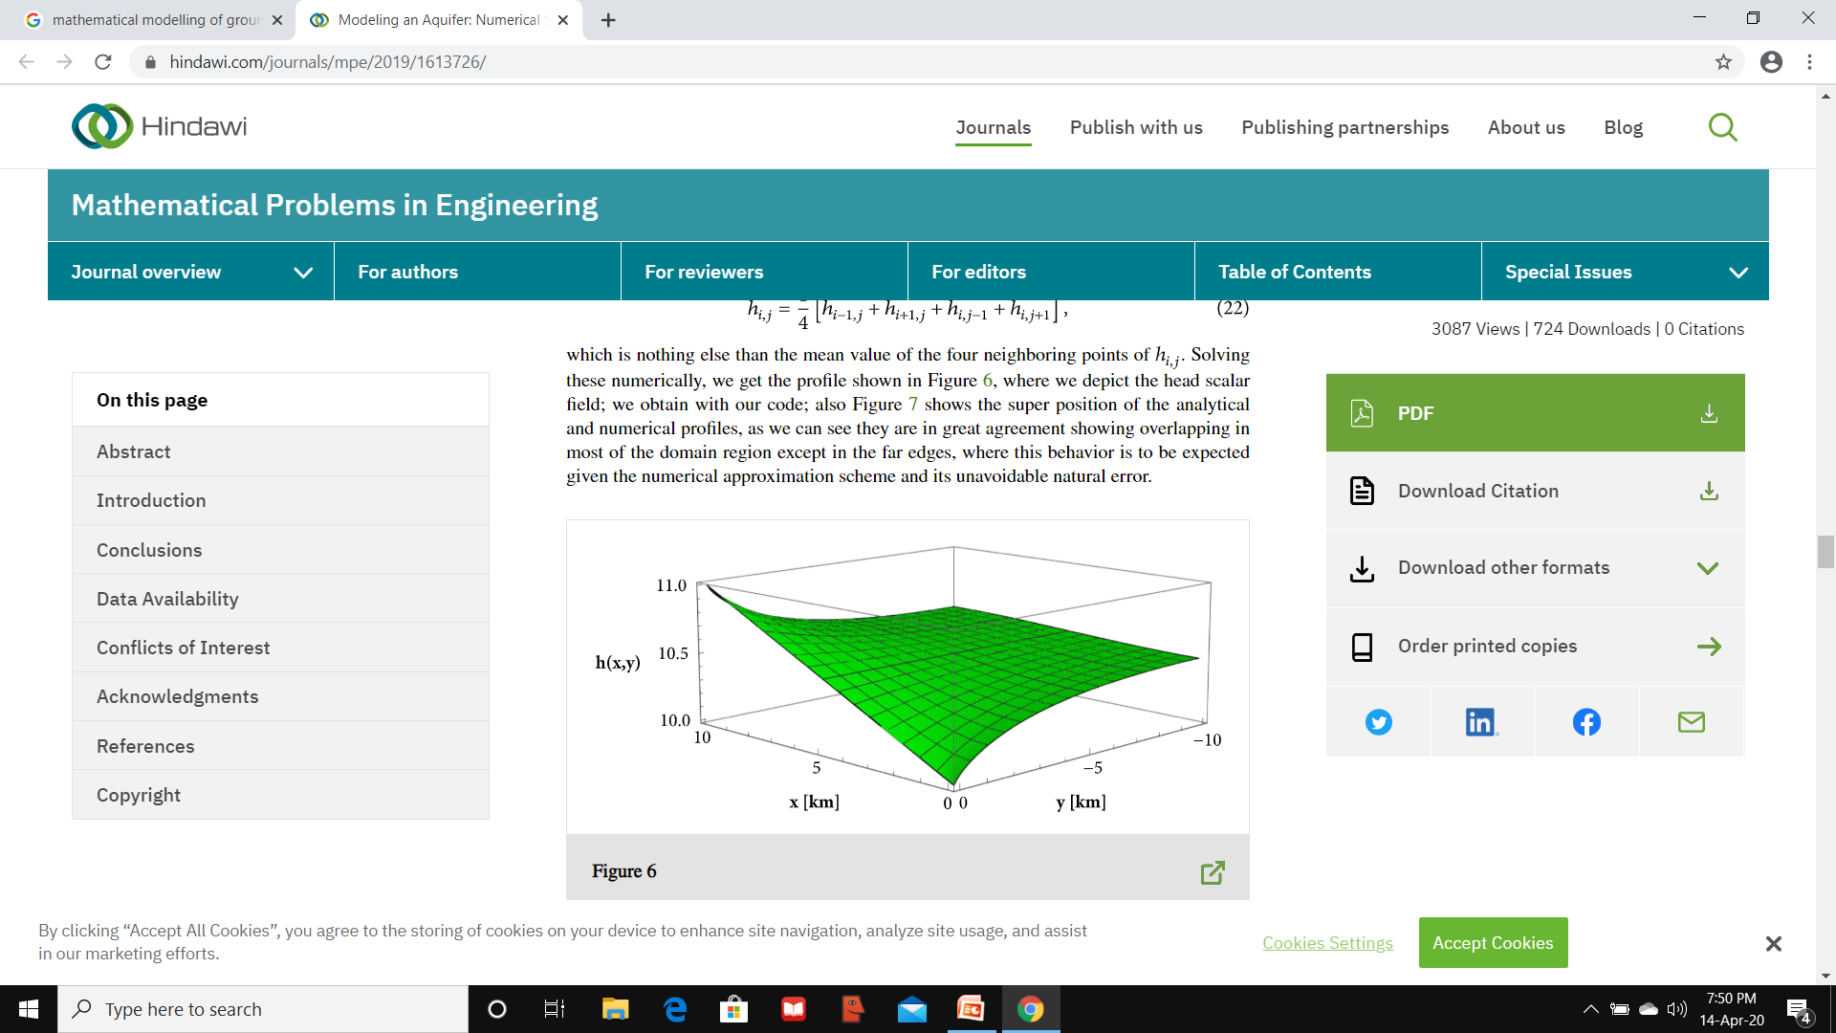
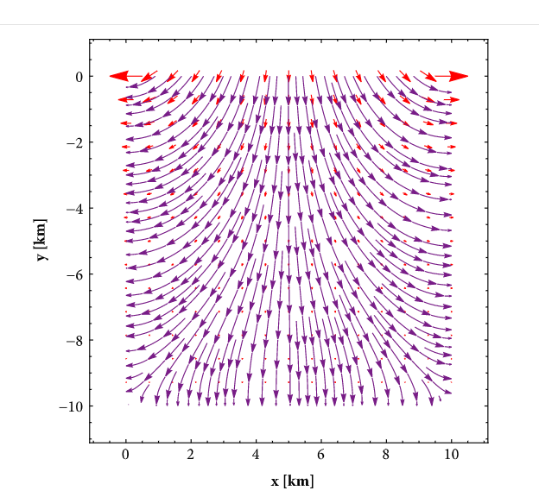
Mathematical models are usually used in the conjunctive use studies
A basin model simulates the responses of a basin to the changes in the variables used for modeling on natural and artificial recharge and pumping.
So that the best operating procedures for basin management can be practiced.

